Slide 1
PFAS: Regulatory Advancements and Lessons Learned on Assessment, Delineation, and Data Interpretation
March 4, 2024

Slide 2
Presentation Overview
PFAS sources and characteristics
Regulatory framework and guidance documents
Key considerations for designing an investigation
Critical planning items and precautions for PFAS assessment
Project scenarios and lessons learned

Slide 3
Acknowledgements
Krista Barfoot
Kate Lindfield
Lindsay Paterson
Infrastructure Sector Leader
Senior Geologist
Senior Soil Scientist
A Contaminated Sites Specialist, Dr. Barfoot has over 25 years of experience with expertise
spanning from the technical elements of project delivery to program management, risk
management, policy development, and stakeholder communication. Her technical expertise includes strategic site planning, risk assessment, vapour intrusion assessment, management of excess soil, non-aqueous phase liquid, risk mitigation measures, and emerging contaminants – including per- and polyﬂuoroalkyl substances (PFAS). Experienced in PFAS investigative and analytical approaches, risk assessment considerations, and remediation techniques, her PFAS project experience includes brownﬁelds, AFFF sites, and landﬁlls.
Kate Lindfield has 20 years of experience in the geo-environmental consulting industry. She has been involved with numerous ESA, remediation, and risk management projects, primarily at downstream petroleum facilities, upstream oil and gas facilities, active military bases, industrial facilities, airports, national parks, and residential and commercial properties located in Alberta, British Columbia, and the United Kingdom. Kate’s experience includes project management, data analysis, senior technical review and support, fieldwork, contractor supervision, estimating, report authoring, remediation/risk management plan development, tender support, and client/regulatory liaison.
Lindsay is a senior scientist with 23 years of experience in the environmental consulting industry, including 17 years of experience in investigating, remediating and risk managing PFAS contaminated sites across Canada. She has directed extensive drinking water and agricultural sampling programs for PFAS to protect human health, has developed multi-year strategic plans for the risk management of PFAS at large-area sites, and has assisted clients looking to mitigate their risk from PFAS in their operations. She is the primary author of guidance for the investigation and remediation of PFAS which was prepared on behalf of the Society of Contaminated Sites Approved Professionals of British Columbia (CSAP) and has contributed to the development of screening values and guidance documents by Canadian and international organizations.

Slide 4
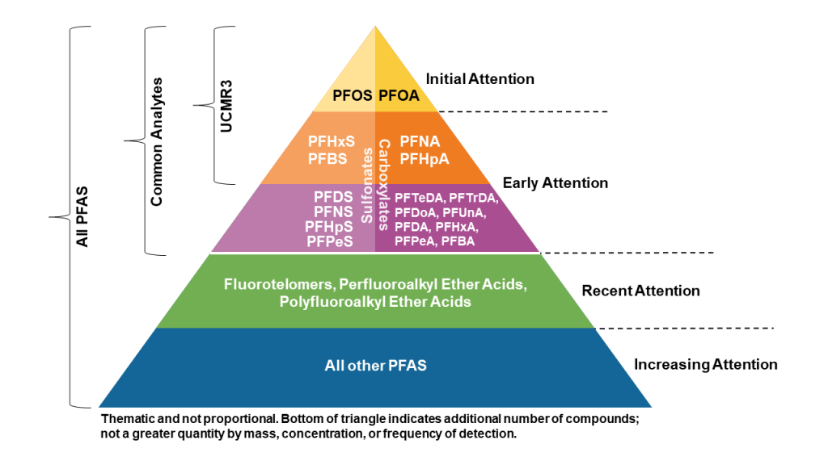
What is PFAS?
Per- and polyfluoroalkyl substances(PFAS) family may include more than 12,000 chemical substances and 4,700 substances on the global market.
Source: IRTC. Fact Sheet - History and Use of PFAS Found in the Environment. September 2023

Slide 5
Sources of PFAS
PFAS raw material manufacturing
PFAS in production of processes
PFAS in industrial products
PFAS in consumer products
Source: Southeast Alaska Conservation Council, 2023

Slide 6
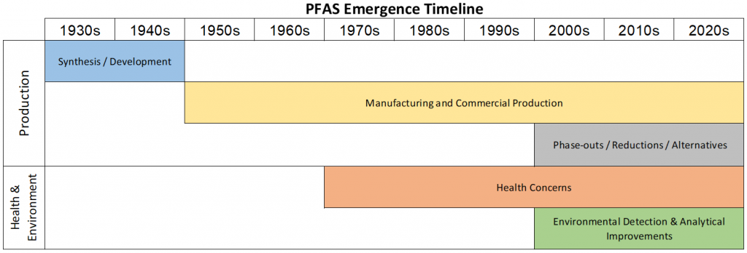
Timelines
Source: IRTC. Fact Sheet - History and Use of PFAS Found in the Environment. September 2023.

Slide 7
PFAS Characteristics and Key Points
Key PFAS are highly water-soluble and non-volatile, and will partition predominantly to water where they can mobilize.
Some PFAS may be volatile and are more likely to be found in the atmosphere. For key PFAS this is often associates with particles in the atmosphere.
Some PFAS can undergo transformation to form more stable PFAS that are extremely persistent in the environment under ambient conditions.
Some shorter-chain PFAS have proven to be even more mobile on a local scale than longer chain PFAS.
Some PFAS are also capable of undergoing long-range transport in the atmosphere or in global ocean currents, demonstrated by widespread distribution around the world.
Experience with PFAS-contaminated sites has shown that remediation and management of these sites are very challenging and complex.

Slide 8
PFAS Regulation

Slide 9
Criteria Across Canada - Current
Agency | Water | Soil
Health Canada | DW Guidelines for 2 PFAS, and 9 DW Screening Values for 9 PFAS | Soil Screening Values 10 PFAS, defaults to CCME for PFOS
ECCC* | PFOS SW guideline (eco based) | None to date
CCME | PFOS GW guideline (DW based) | PFOS soil guideline (leaching to potable DW & eco based)
British Columbia (Regulated)* | PFBS, PFOS, PFOA (DW); PFOS (aquatic life) | PFOS (leaching to potable GW is driver), PFBS (human health)
Alberta (Regulated) | PFOS and PFOA GW criteria (protection of aquatic life and drinking water pathways) | PFOS soil guideline (human and eco considerations)
Atlantic Canada (PIRI Regulated) | EQS for 9 PFAS in GW; 1 PFAS in SW | EQS for 9 PFAS
Quebec | PFOS and PFOA SW and GW criteria | None to date
Ontario | Potable GW criteria for sum of 11 PFAS | None to date
* ECCC and BC also have tissue guidelines

Slide 10
Proposed Drinking Water Criteria
Primary exposure pathway of concern is ingestion of drinking water
Agency | Proposed Criteria | Notes
AEPA | Total PFOS – 600 ng/L Total PFOA – 200 ng/L | 2022 Alberta Tier 1 Guidelines (August 2022) Additionally, the sum of the ratios of the detected concentrations to the corresponding MACs for PFOS and PFOA should not exceed 1.
Health Canada | Total PFAS – 30 ng/L | 2023 DW Objective (February 8, 2023); sum to include a minimum of 18 PFAS. Intended to replace the PFAS DW Guidelines and Screening Values.
USEPA | PFOA – 4 ng/L PFOS – 4 ng/L PFNA, PFHxS, PFBS, GenX – Hazard Index 1.0 | 2023 MCLs (March 14, 2023)
 | PFOA – 0.004 ng/L PFOS – 0.02 ng/L | 2022 Interim HAs (June 15, 2022) (previously was 70 ng/L individually and as a sum of PFOA and PFOS)
 | GenX – 10 ng/L PFBS – 2,000 ng/L | 2022 Final HAs (June 15, 2022)

Slide 11
Assessment and Planning Considerations

Slide 12
Historical Data Review and Identification of APECs
Records review
Previous environmental studies
Product storage records
Fire station records
Incident reports
Spill reports
Product storage and management practices
Maintenance activities
Utility drawings and as built plans
Additional Searches
ERIS records
Aerial photos and satellite imagery
City directories
Fire insurance plans
Land titles and legal plans
Municipal records
Other database searches
Interviews
Site Visit

Slide 13
Work Plan Development
Things to Consider | PFAS Considerations | Example
Source Areas | Current and historical PFAS uses | Fire training areas, product storage, incident locations, metal plating areas
Secondary Sources | Soil Relocation or Water Discharge Areas | Spoil piles, soil reuse locations, landfarming, retention ponds, sewage lagoons, and discharge areas
Overland Drainage | Surface Water Run-off and Ditches | Overland flow to low lying areas, ditches, and water bodies
Groundwater Migration | Groundwater Flow Direction and Gradient | Domestic use aquifers, water well users, discharge locations
Sensitive Receptors | Human and Ecological Receptors | Water bodies, water wells, gardens, homes,

Slide 14
Investigation Plan
Borehole and monitoring well locations
Type of drilling methods and sampling methods
Step into your source areas, start with delineation boreholes
Subcontractor and staff availability and training
Distribute PFAS expectations to the team
Develop a field scope of work

Slide 15
Sampling and Analysis Plan
Organizes the PFAS considerations in one planning document that can be communicated to the client and shared with the field team
Sampling locations and rationale
Sample collection methods
Media to be assessed and numbers of samples
Analysis specifics
Analytical program
Data quality program
Waste management plan

Slide 16
Analytical Program and Data Quality
Develop a sampling plan and analytical program in advance (consider targeted or non-targeted analysis like TOF or TOPA, detection limits)
Sample handling processes to be followed (labelling, packing, storing, and submission)
Confirm the PFAS suite of analysis and detection limits
Select laboratory TAT (regular vs rush) and confirm with lab
Review hold times and consider extending sample hold time to 60 or 90 days
Timely review of lab reports is critical, identify any data flags and follow up
Check for blanks, duplicates, and surrogate recovery
Request lab data checks and reanalysis as needed

Slide 17
Source Water Pre-Testing and Waste Program
Key considerations for any PFAS assessment program:
Advanced analysis of source water and wash water to be used during the work, with preservative where required.
Planning for wastes streams generated during the work. Coordinate waste characterization and disposal.

Slide 18
Field Guidance Documents
Clothing to be of natural fibres and well laundered
Nitrile gloves worn and changed frequently
PFAS-free field equipment
Avoid contact with products that could cause cross contamination
Record field notes on regular paper using masonite clipboards
Use laboratory supplied labels using a ballpoint pen.
Shower the night before and rinse with water only on the day of sampling
Limit visitors to the site
Use only pre-tested PFAS free water supply
Follow decontamination procedures
Transport Canada. PFAS Field Sampling Guidance. 2017.
ITRC. Sampling Precautions and Laboratory Analytical Methods for PFAS. August 2020.
Bureau Veritas. Sampling and Analysis for PFAS.

Slide 19
Project Scenarios and Lessons Learned

Slide 20
PFAS Presence/Absence Assessment at an Active Facility
Client Needs
Assessment for chemicals associated with historical fire training activities was requested by AER in January 2022, when Alberta Tier 1 Guidelines added PFOS and PFOA as regulated parameters.
SLR Role
No previous testing for PFAS had been completed.
Identify areas of potential environmental concern.
Develop an assessment plan to confirm whether impacts were present.
Include the results in the operational soil monitoring program.
Confidential Midstream Client
Alberta
Canada
Historical Data Review
Assessment Plan
PFAS Soil and Groundwater Assessment
Regulatory Reporting

Slide 21
Assessment and Delineation at a Former Fire Training Area
CHALLENGE
Assessment and delineation of previously identified PFAS impacts at a former fire training area with historical use of aqueous film forming foams. At the time it was common practice to remediate hydrocarbon impacts associated with the fire training areas with no testing for PFAS. PFAS impacts often extend beyond the hydrocarbon impacts due to their mobility and persistence in the subsurface, this results in residual PFAS plumes that require assessment. Limited guidelines in place means that at times guidelines do not exist to address important exposure pathways.
SOLUTION
IMPACT
Confirm concentrations in source areas
Complete vertical delineation in areas of previously identified impacts
Lateral delineation at property boundaries and between source areas and receptors
Review of surface water drainage and asse
Develop a conceptual site model for the site and the impacts
Screening level risk assessment to determine whether complete exposure-pathway-receptor scenario identifies risks to human or ecological receptors
Professional judgement may recommend testing of other media to assess risks to human health and the environment
Delineation of impacts to environmental and human health guidelines
Assessment of risk to receptors where applicable
Ability to move forward with implementing risk management or remedial action plans

Slide 22
Next Steps After Assessment
Once assessment and delineation are complete, and you have developed a comprehensive conceptual site model, you are ready to move on to the following:
Exposure Controls
Remedial Action Plan
Risk Management Plan
Risk Assessment
PFAS regulations are changing and evolving throughout jurisdictions as available research and scientific understanding advances.

Slide 23
Do you have any questions?

Slide 24
Nikki Hilker
Energy Subsector Lead - Downstream
E nhilker@slrconsulting.com

