Slide 1
Quality Assurance of Lab Results
Jeff Zimmer,
Manager, SRC Environmental Analytical Laboratories

Slide 2
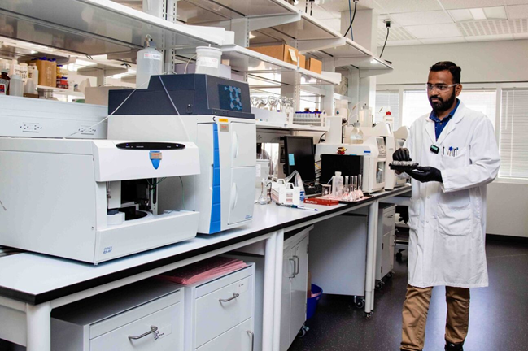
Outline
Quality
Lab data
Accreditation
Different QC techniques
Uncertainty

Slide 3
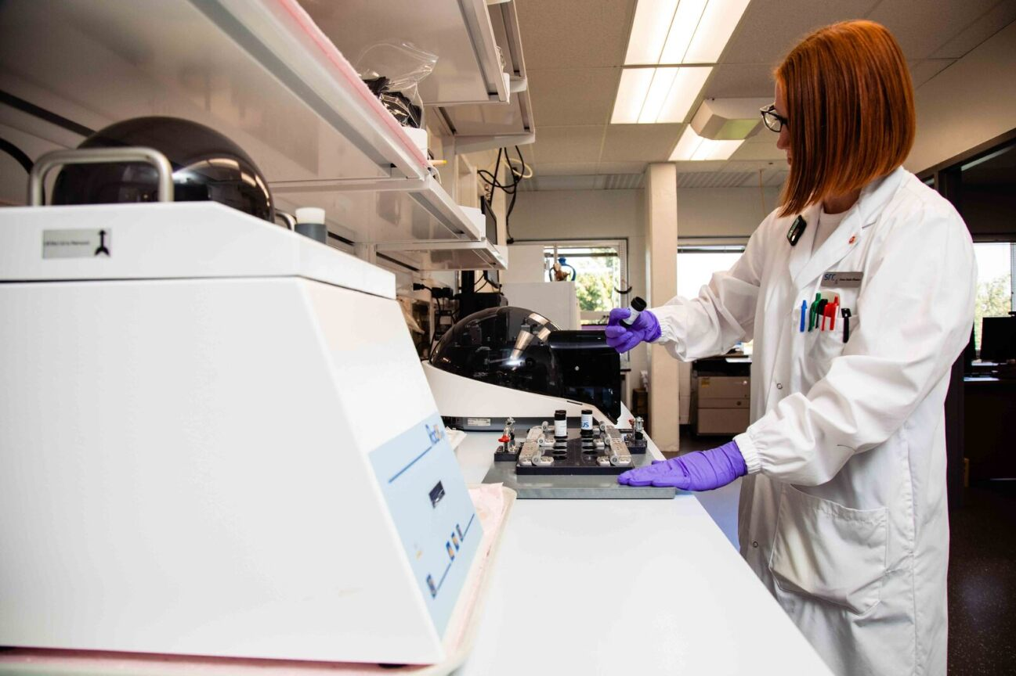
Quality – What is it?
T-shirt example
Quality is defined by the customer!

Slide 4
Quality – What is it?
Quality Objectives
Ideally pre-defined
Based on
Decisions
Desired outcomes
Allowable risk for the project
Techniques (testing availability)
Customer specifications
Work with lab to assess if your needs are met

Slide 5
Quality – What is it?
Uncertainty
Considerations:
Often biggest source of uncertainty is sampling
Transport, handling and storage can contribute
How will uncertainty impact your decisions
Decision rules in meeting requirements

Slide 6
Accreditation
Accreditation to ISO/IEC 17025:2017
Requirement for drinking water tests (most provinces)
Increasingly adopted by regulatory agencies
Wastewater and other environmental tests
Minimum expectation for a lab

Slide 7
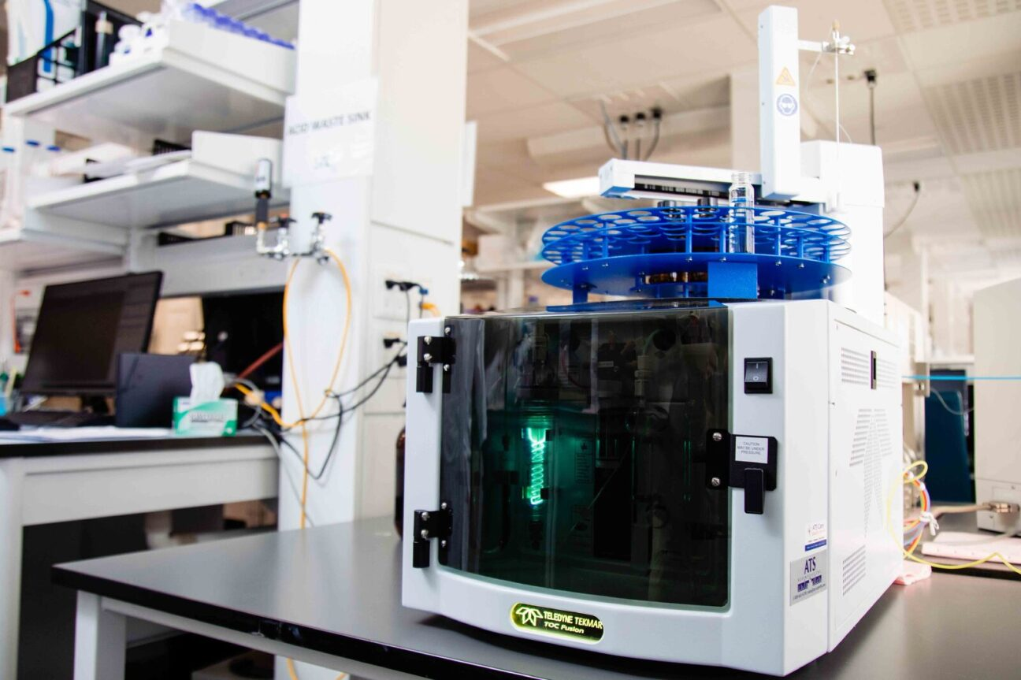
Accreditation
Broad-based requirements of accreditation:
Quality System
Management reviews
Internal Audits
Continual Improvement
Proficiency Testing
Document Control
Although broad based requirements are in place, accreditation is granted for specific parameters

Slide 8
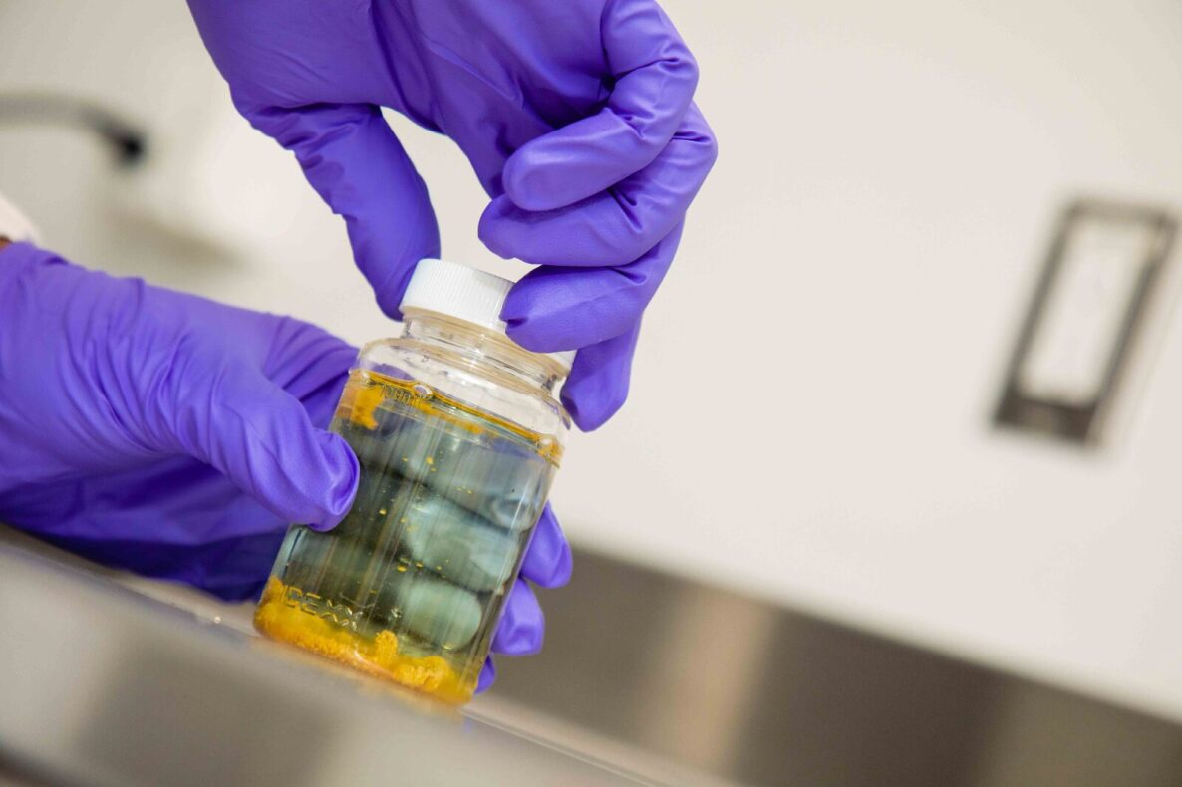
Accreditation
Some requirements of accreditation that you should be aware of:
Cooperation with clients
Solicitation of feedback
Response to complaints

Slide 9
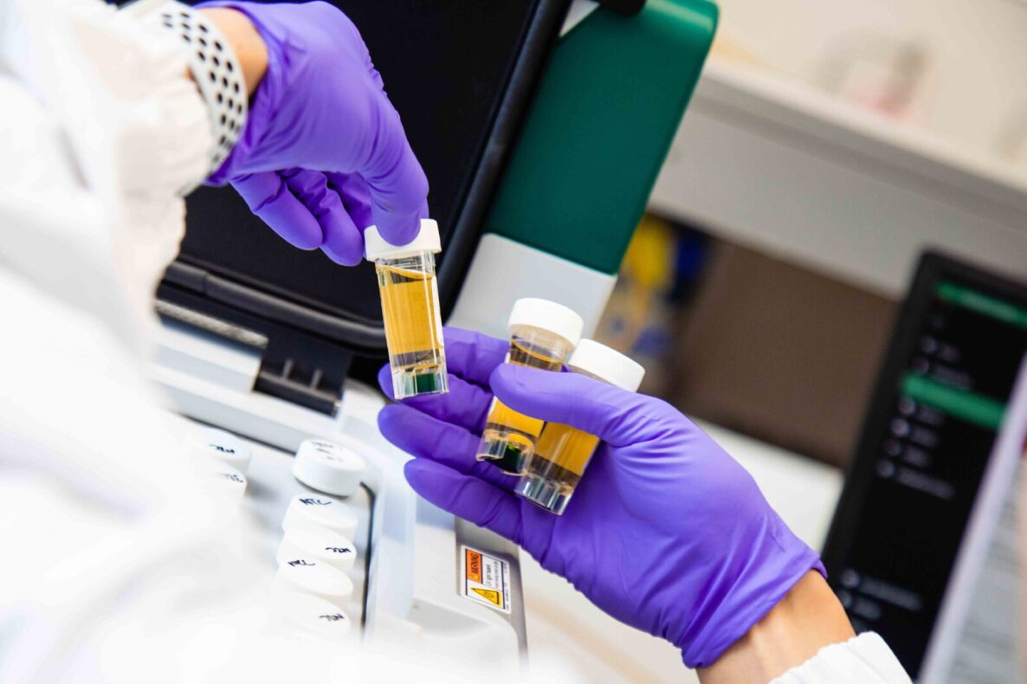
Lab Data
Where do errors come from?
Human
Mislabeling, mix-ups, incorrect processing
Sample
Interferences, homogeneity,
Processing
Instrument drift, reagent purity
Calibration
Standards, dilutions, accurate representation of sample

Slide 10
Quality Assurance Tools
QC Tools
Specifications or requirements
Hard and fast rules on if something is okay or not
Calibration
Control samples
Duplicates
Internal standards
Spikes, blanks, verification standards, etc.

Slide 11
Quality Assurance Tools
Calibration requirements
Duplicates
What do they tell us?
Typically evaluated by % Difference
Watch the calculation here.
Commonly done 2 different ways:
(x₁-x₂)/x_{avg} * 100%
(x1- x_{avg} )/ x_{avg} * 100%
Field duplicates
A tool that can be used by lab clients
Assess uncertainty associated with sampling

Slide 12
Quality Assurance Tools
Blanks
Field; Trip
Assess unexpected contamination in the field
Method
Assess all processing steps in method
Reagent
Control samples
Standard or reference material that goes through all method steps

Slide 13
Quality Assurance Tools
Spikes
Can be useful for assessing issues with sample matrix (or processing)
They don't always work
Dependent on ratio of analyte in spike and sample

Slide 14
Proficiency Testing (PT)
Interlaboratory Programs
Samples prepared to contain the same amount of analyte
Distributed to several labs for analysis
Statistical analysis of data reveals any issues
Confidential results provided to lab
Lab provides PT results to their accreditation body
Not always available

Slide 15
Uncertainty
Relates to the required Data Quality Objectives
Typically determined in lab via stats
Lab data that can be used to estimate uncertainty
Control Samples,
Duplicates
PT samples
Method validation data

Slide 16
Uncertainty
Uncertainty can be expressed directly
Example: 103 ± 5
Significant figures imply a level of uncertainty
Example: 103
Implication is that the uncertainty in the result is primarily associated with the last significant figure
Remember uncertainty is an estimate

Slide 17
Summary
Customer determines the quality
Understand your quality objectives
Uncertainty helps to understand data
Many QC tools to ensure integrity of lab data
Don’t be afraid to ask for this info
Accreditation
A basic, but important tool for ensuring lab quality
Things happen
The lab’s response is key to your response
Make sure you are satisfied with their explanation

Slide 18
Questions?

Slide 19
Jeff Zimmer
Manager, SRC Environmental Analytical Laboratories
306-933-5204
Jeff.Zimmer@src.sk.ca

