Slide 1
Identifying and Addressing False Petroleum Hydrocarbon Detections from Natural Organics
Sustaintech 2024
Dwayne Bennett, P.Chem.
March 2024

Slide 2
Safety moment – Travel Safety
Plan ahead!
Plan your trip. Review road conditions and weather.
Check your vehicle to make sure there’s no issues prior to driving.
For long trips, having a second relief driver can reduce fatigue.

Slide 3
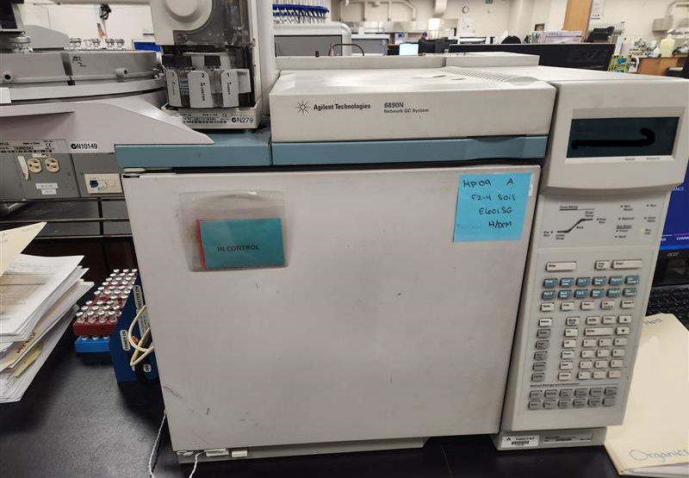
Agenda
An introduction to Hydrocarbon Analysis
  CCME CWS Tier 1 Analysis.
Hydrocarbon Distribution Reports
  What to expect if you have hits?
  Evaluations of weathering processes.
Silica Gel clean-up.
  Options between in-situ and column clean up.
Biogenic Interference Scale (BIC).

Slide 4
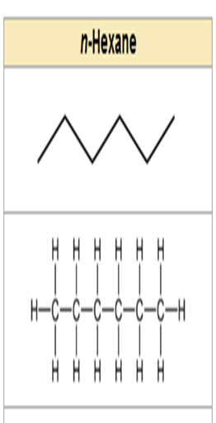


Hydrocarbons Introduction
Hydrocarbons are organic chemical products containing hydrogen and carbons.
Hydrocarbon products include several mixtures such as gasoline, diesel, and lubricating oils.
Typical components will have hydrocarbons with carbon number between n-C5 to n-C60.
Notes:
‘n-’ denotes straight-chained hydrocarbons rather than including branched carbons.

Slide 5
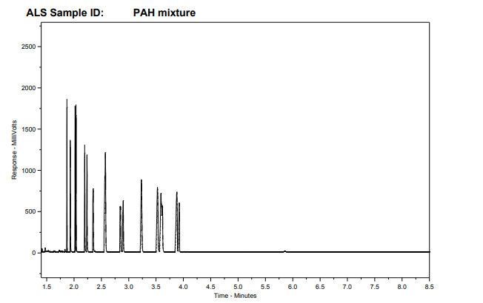
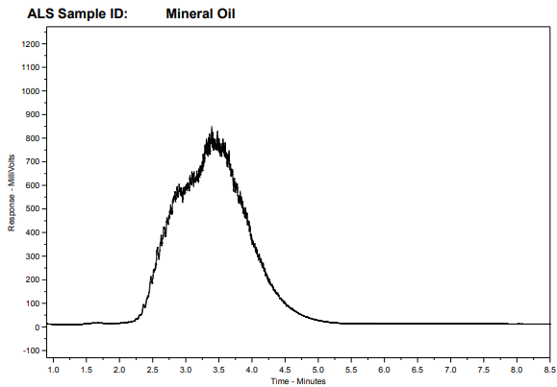
Hydrocarbon Analysis
Hydrocarbons are typically analyzed by gas chromatography coupled with an FID detector.
Hydrocarbons are separated by boiling point with heavier hydrocarbons eluting later than earlier hydrocarbons.
Petroleum hydrocarbon mixtures will present as unresolved complex mixtures or UCMs .
Discrete organic compounds (such as individual PAHs) will present as individual peaks.
Notes:
‘n-’ denotes straight-chained hydrocarbons rather than including branched carbons.

Slide 6
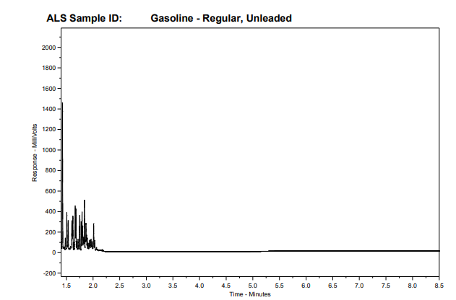
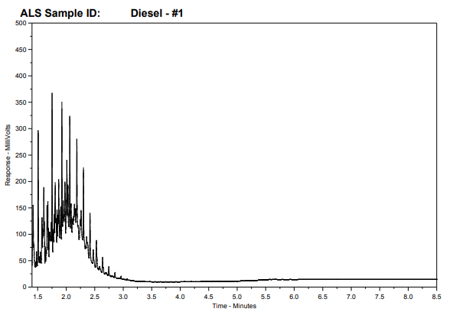
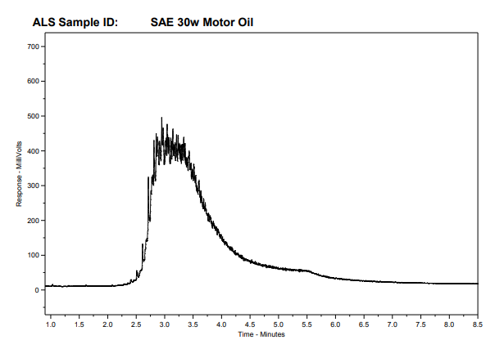
Hydrocarbon Analysis
Different hydrocarbon products will be made up of a variety of organic products:
  Gasoline range hydrocarbons (GRO) would fall between n-C4 to n-C12.
  Diesel Range hydrocarbons (DRO) would fall between nC9 to n-C23.
  Lubricating oils are heavier and fall between n-C23 to n-C60.

Slide 7
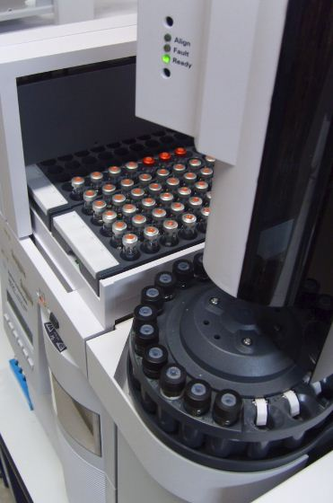
CCME Canada Wide Standard
CCME created a Canada wide standard for hydrocarbon fractions in 2001.
Prescriptive elements of this method included:
  Precise definitions of the hydrocarbon ranges.
  Specific elements including GC column.
  Quality control elements regarding evaluation of the chromatogram and data.
Analysis is split between two separate elements:
  Fraction 1 (“F1”) Gasoline range C6 - C10 Methanol Extraction.
  Fraction 2 (“F2”) to Fraction 4 (“F4”) C10-C50 Acetone:Hexane Extraction.
    F2 - C10-C16
    F3 – C16-C34
    F4 – C34-C50
  Gravimetric determination can also be performed if significant hydrocarbons are present in the F4+ range (“F4G”).
Notes:
Need a picture!

Slide 8
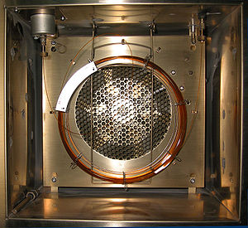
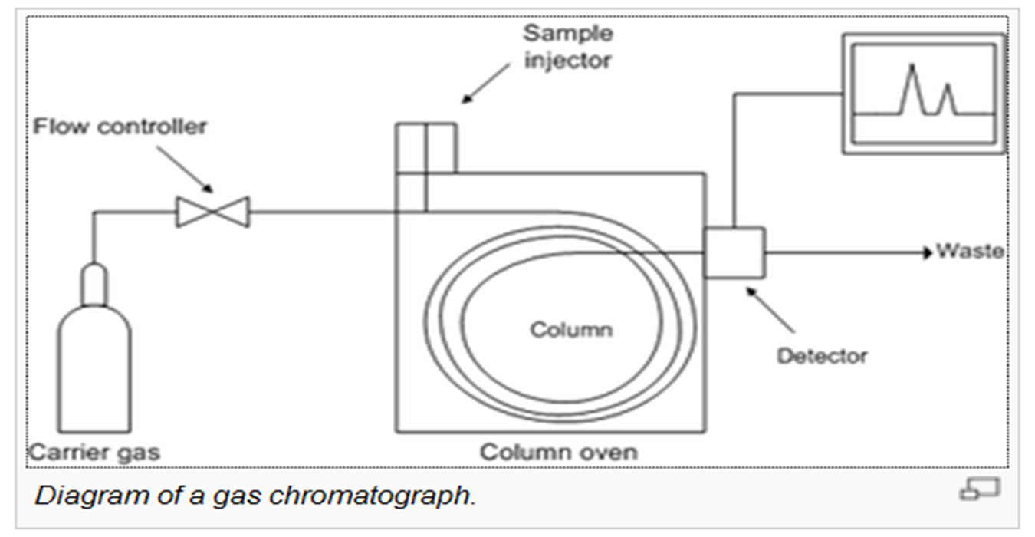
Gas Chromatography
Gas Chromatography is a chromatographic technique which uses a column to separate analytes.
A carrier gas flows through the column carrying the sample. Some components will travel faster than others.
A temperature program is used to increase temperature at a controlled rate allowing for components with higher boiling point to elute.
For PHCs, a flame ionization detector is used but other detectors can be used for other applications.

Slide 9
Hydrocarbon Distribution Reports

Slide 10
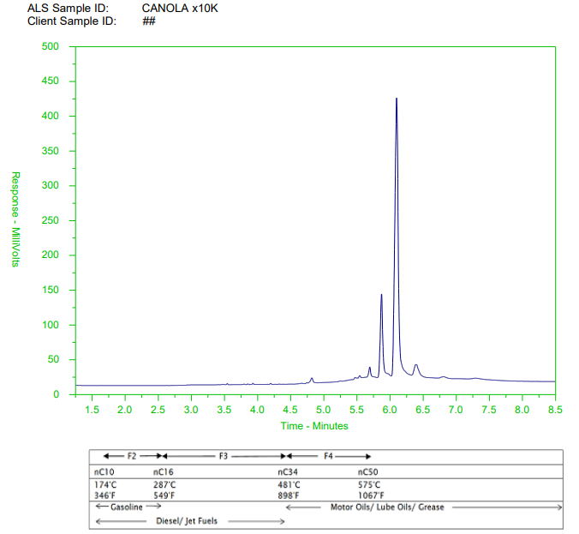
Hydrocarbon Distribution Reports (HDR)
An hydrocarbon distribution report (HDR) is an attached report included with the data from analysis.
An HDR is a visual representation of the data.
Can be used for qualitative review of the data.
Limited Interpretive data can be gathered from chromatography review.
Limitations:
  Cannot conclusively link a contaminant to a source.
  Often cannot differentiate specific PHC products from similar sources.
  Cannot accurately provide weathering or age dating information.
  Cannot definitively separate complex mixtures of different contaminates.

Slide 11
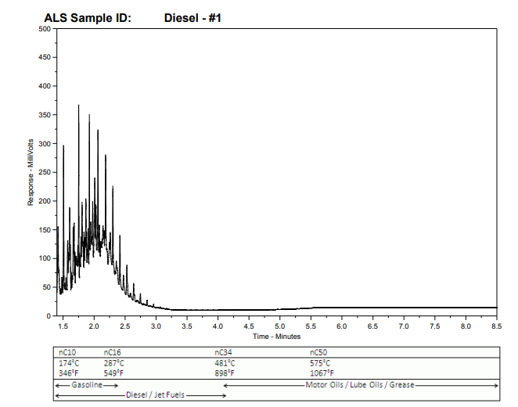
HDR Continued
HDR reports are generated for F2-F4 region. (C10 – C50+)
  F1 range is analyzed separately.
The x-axis is time which is representative of boiling point.
  Heavier hydrocarbons come out further to the right.
So how do we interpret the data?

Slide 12
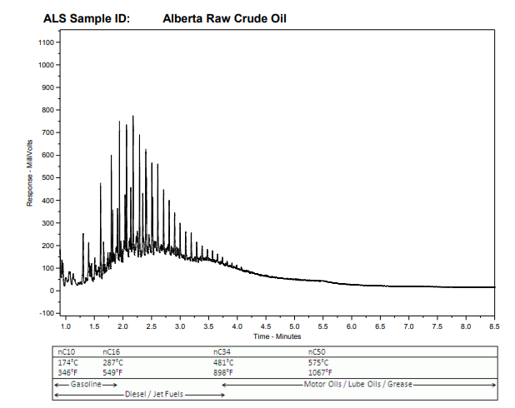
HDR Interpretations
Evaluate the chromatogram range and elution times.
Review chromatogram for unresolved complex mixtures.
Review discrete peaks.
Evaluate against a library analyzed by the same method.

Slide 13
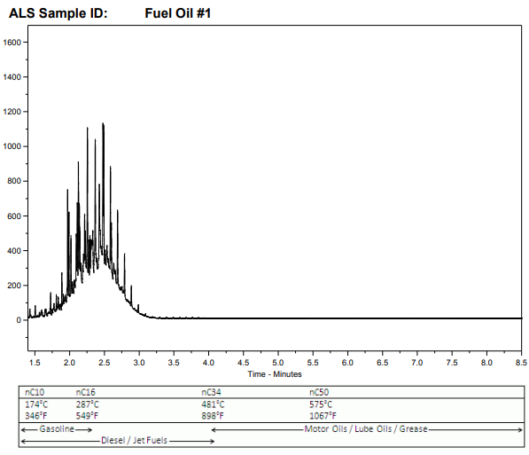
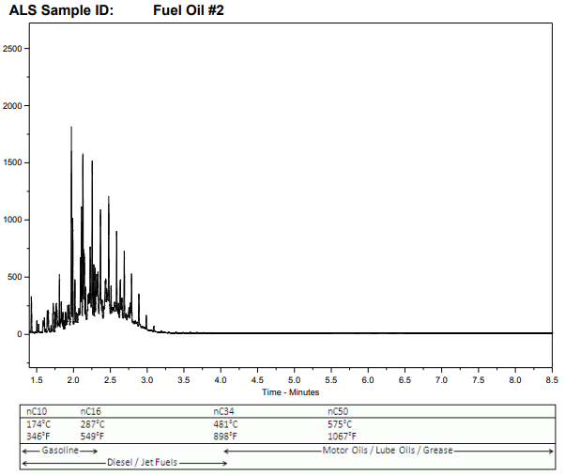
HDR Example (Fuel Oils)

Slide 14

Hydrocarbon Weathering
The process of weathering is complex.
There are various pathways:
  Physical processes.
    Evaporation
    Dilution (Water washing)
  Biological processes (Biodegradation).
Different processes can change the weathering profile.

Slide 15
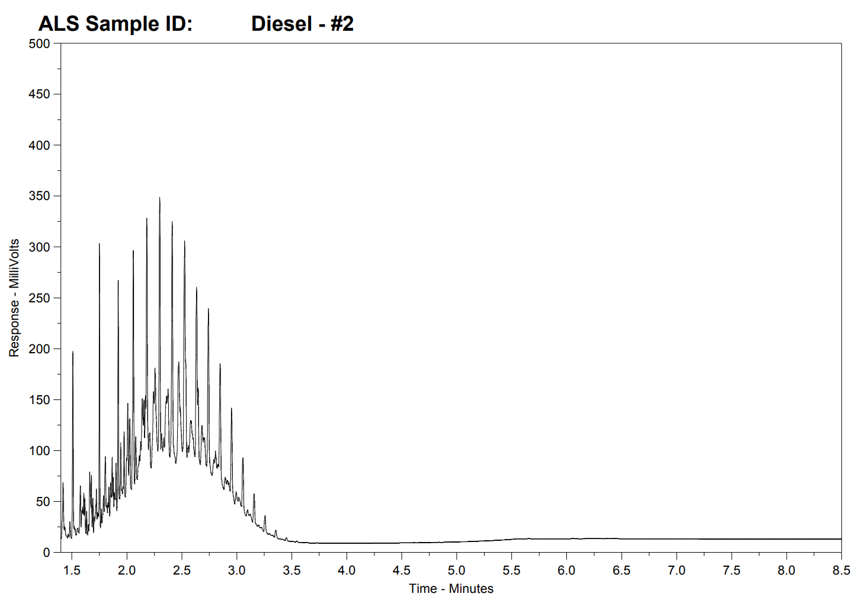
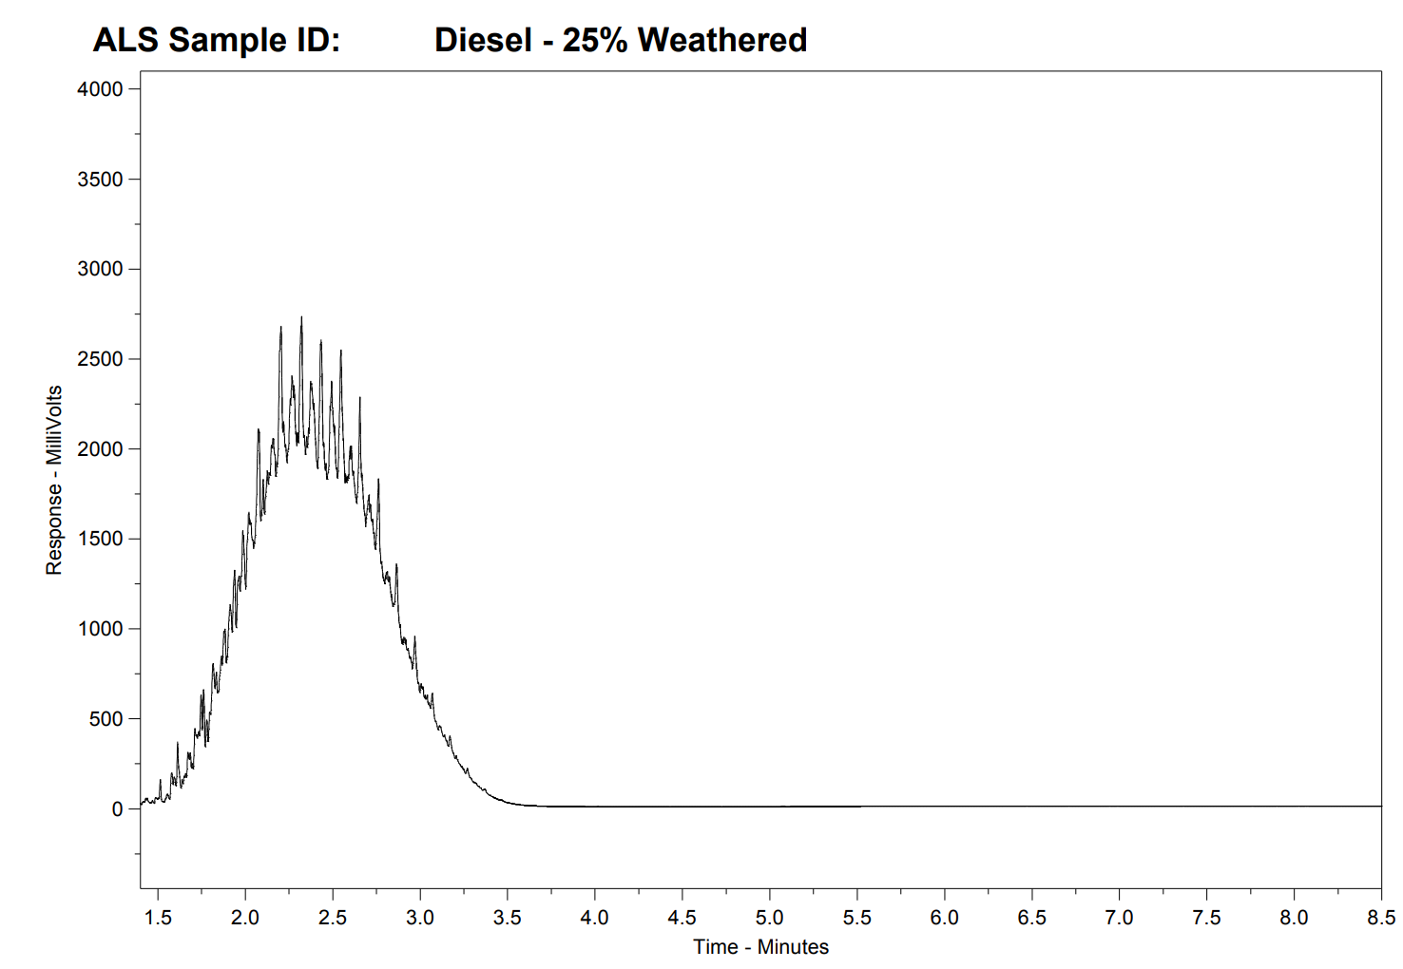
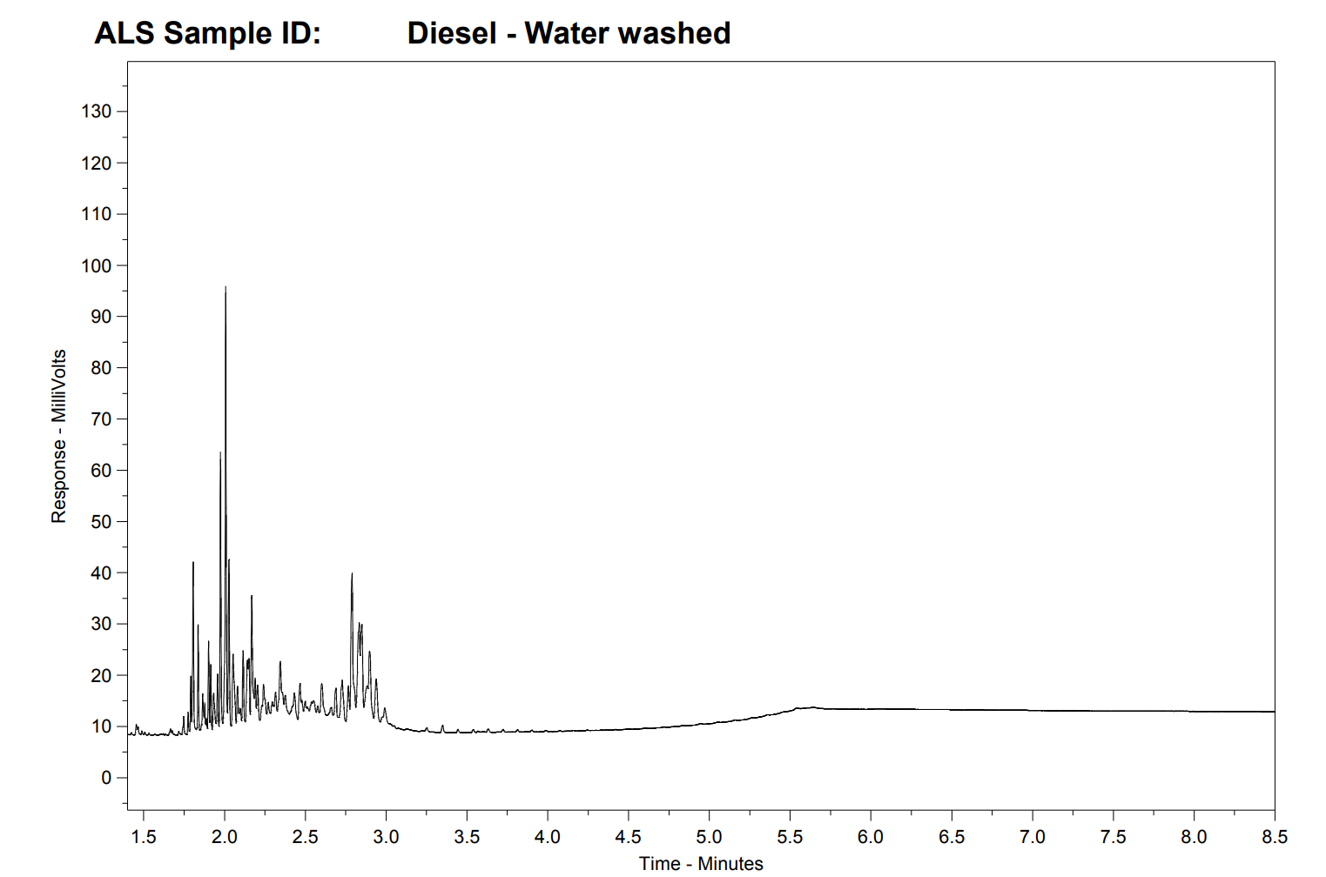
Diesel Weathering Examples
Diesel
Water Washed
Diesel
Diesel
Evaporation
Notes:
Weathering (evaporative) causes lighter hydrocarbons (<nC12) to be lost first.

Slide 16
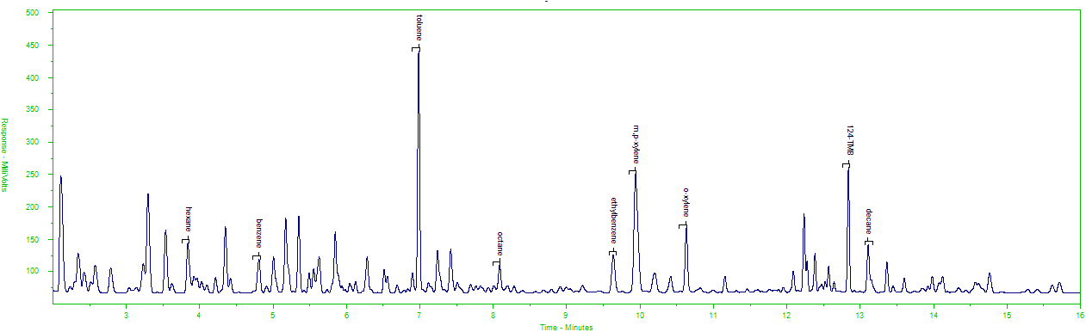
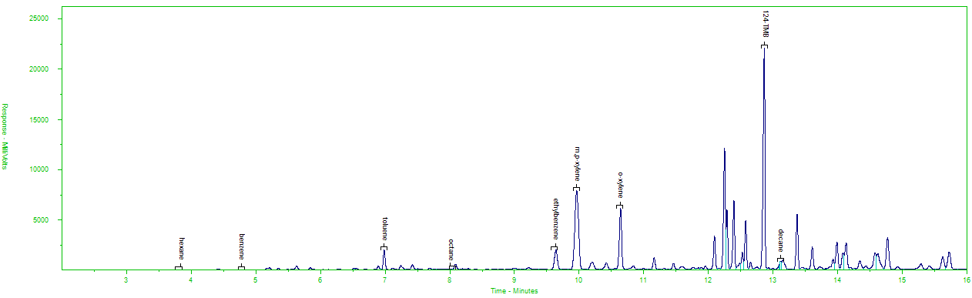
Example of Gasoline Weathering
Unweathered Gasoline
Note: F1 Chromatograms shown here.
Evaporatively Weathered Gasoline

Slide 17
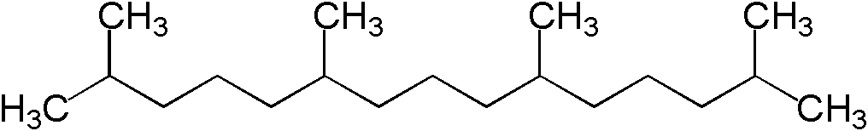

Microbiological Weathering (Biodegradation)
Biodegradation will affect certain analytes quicker than others.
Highly branched alkanes (Isoprenoids) are resistant to weathering.
Ratio of Pristane to nC17 can be used to estimate weathering time:
  Ratio of ~2.3 for fresh middle distillate fuels.
  Drops to near zero if severely bio-degraded.
Pristane (C19 isoprenoid) Phytane (C20 isoprenoid)
Least Stable → → → Progressive Loss by Biodegration → → → Most Stable
light n-alkanes | benzene & toluene | heavy n-alkanes | Alkylbenzenes, alkylcyclohexanes | Isoprenoids, C1/C2 naphthalenes | PAHS | Biomarkers

Slide 18
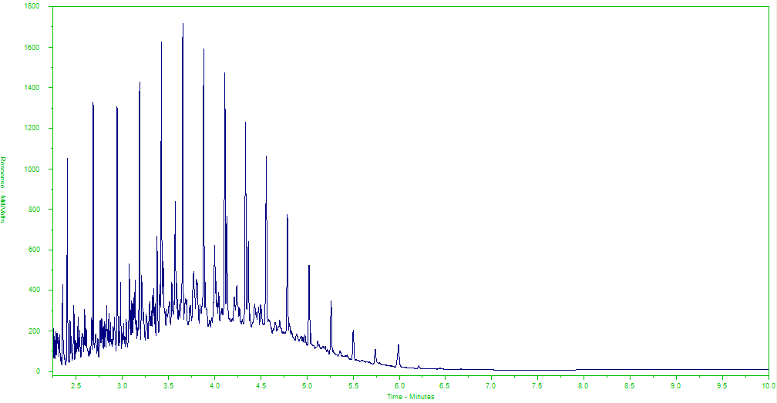
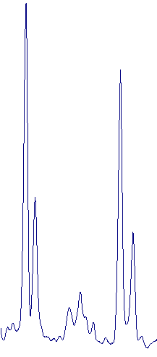
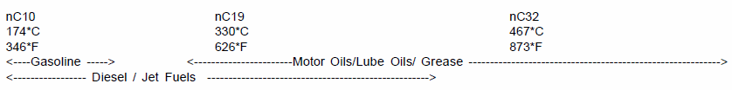
Diesel Example (unweathered)
nC17
Pristane
nC18
Phytane

Slide 19
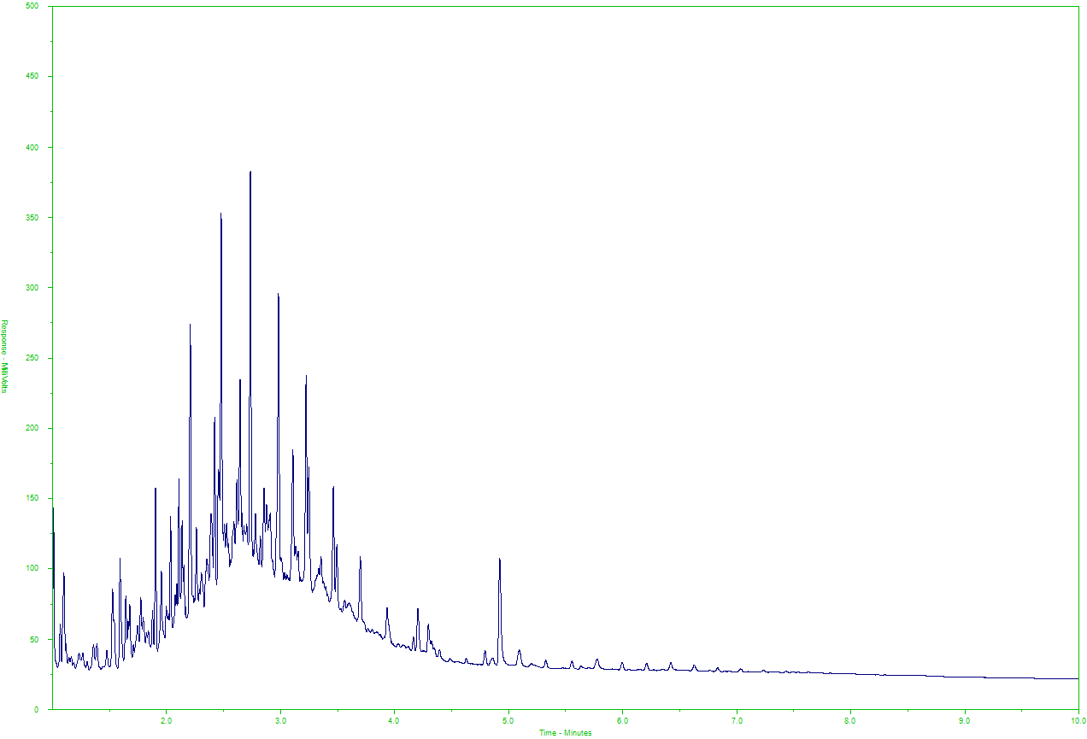
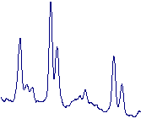
Diesel (Moderately Biodegradated)
nC17
Pristane
nC18
Phytane

Slide 20
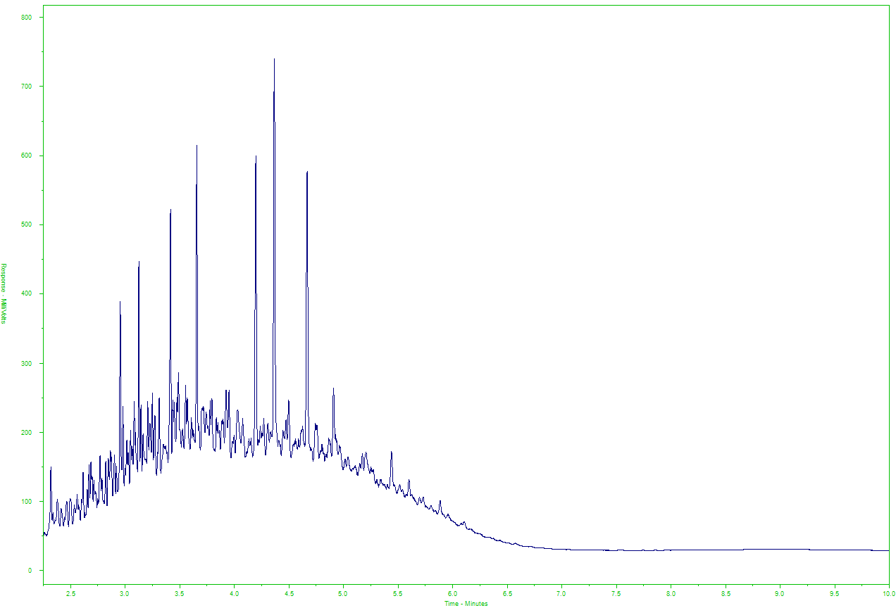
Diesel (Highly Biodegradated)
C13 Isoprenoid
C14 Isoprenoid
C15 Isoprenoid
Farnesane
Norpristane
Pristane
Phytane

Slide 21
Biogenic Interferences

Slide 22
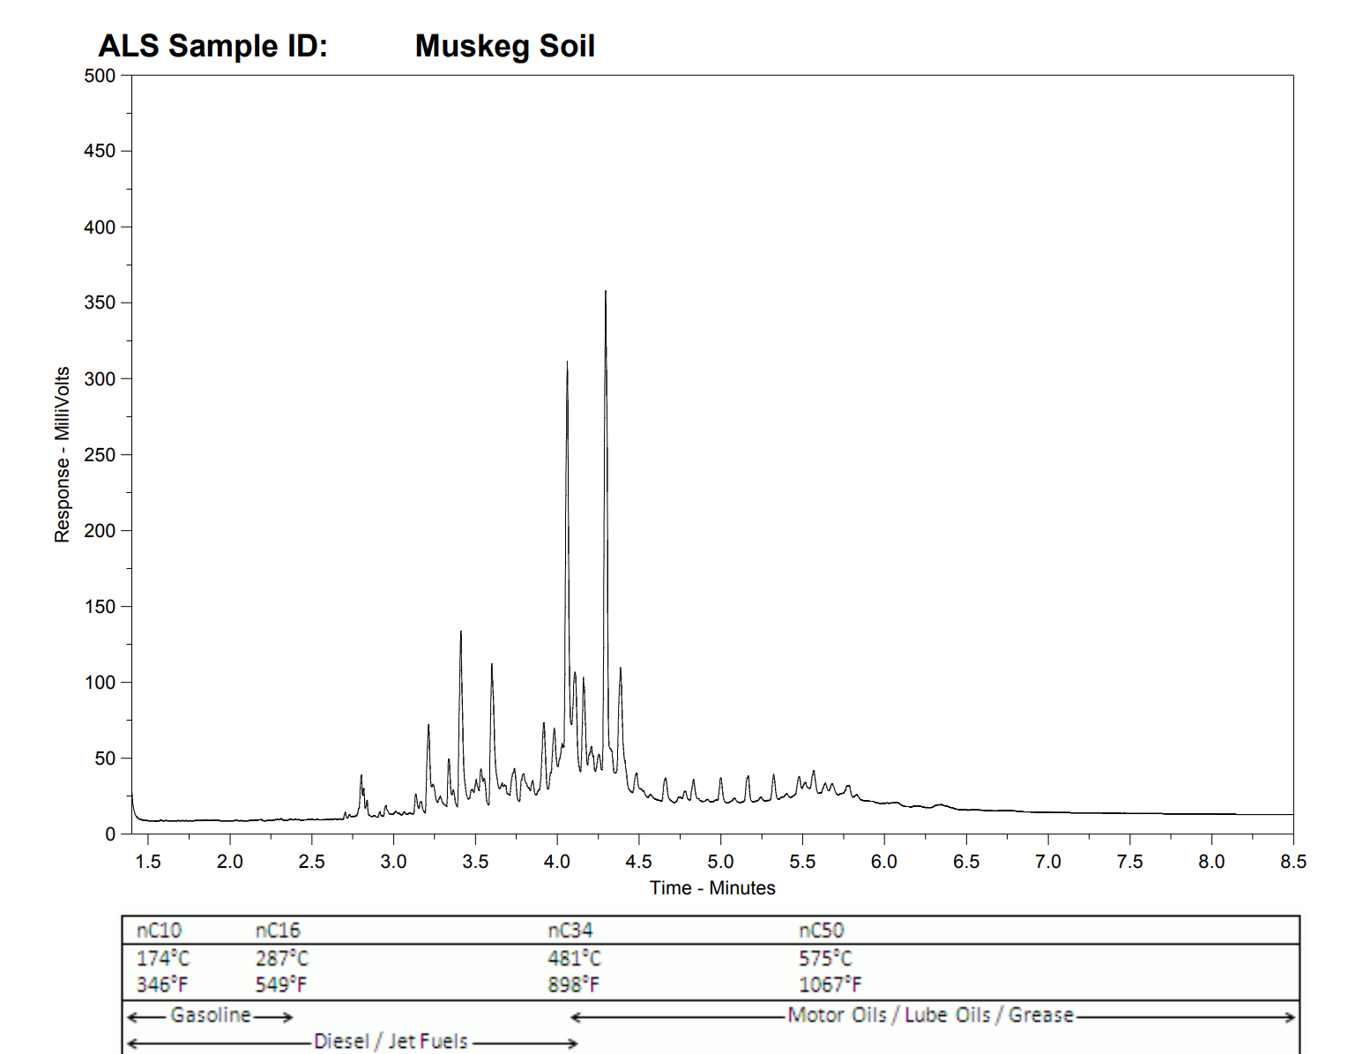
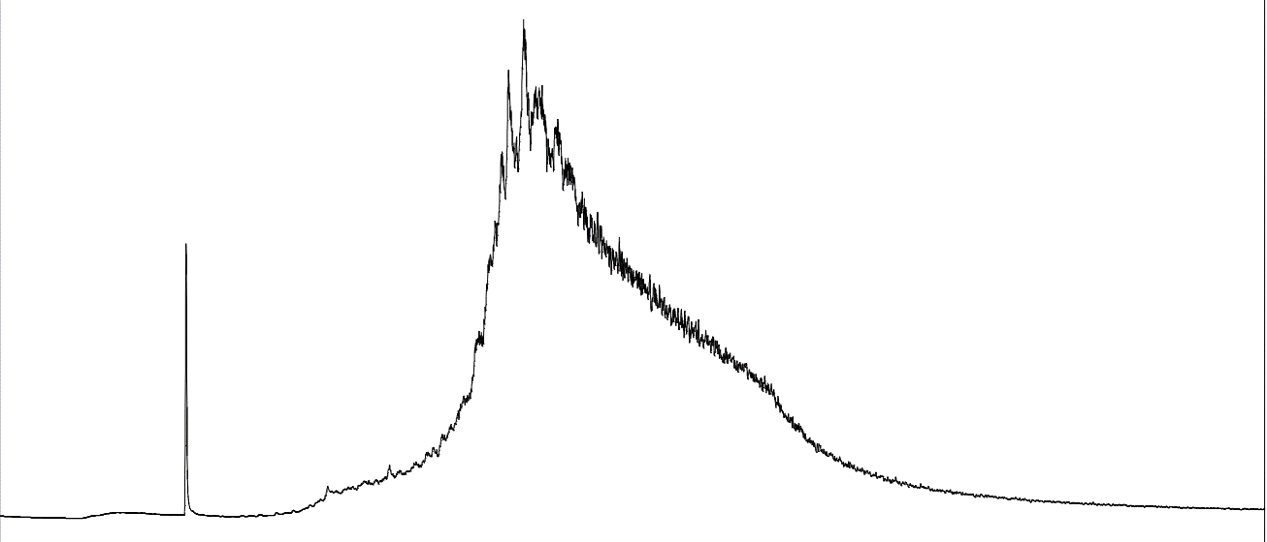
Identifying Biogenic Contamination
Biogenic hits will extract into hexane:acetone.
Will provide chromatograms which can be difficult to distinguish from petroleum hydrocarbon impacts.
Distinct peaks which are associated to odd numbered alkanes can be associated to biogenic sources.
Lots of individual peaks with a small to no UCM.
SAE 50w Motor Oil

Slide 23
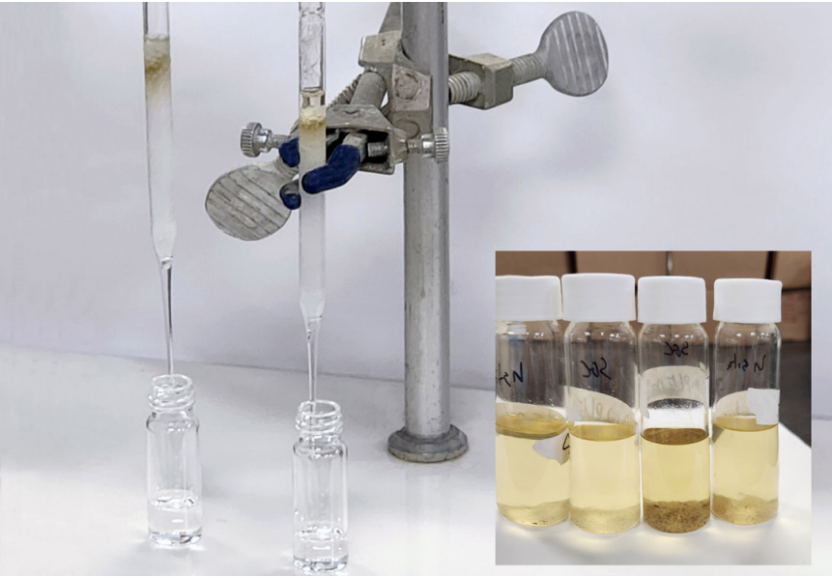
Biogenic interference Removal: Silica Gel Clean-Up
Silica Gel removes naturally occurring interference from samples.
  Binds polar compounds while leaving non-polar compounds intact.
Two primary methods of Silica Gel Clean-Up can be performed:
  In-Situ Clean-Up:
    Default for CCME analysis.
    Silica gel added directly to extract prior to analysis.
  Column Clean-Up:
    Sample is passed through a Silica Gel column.
    Higher surface area.
    More effective for severely impacted samples

Slide 24
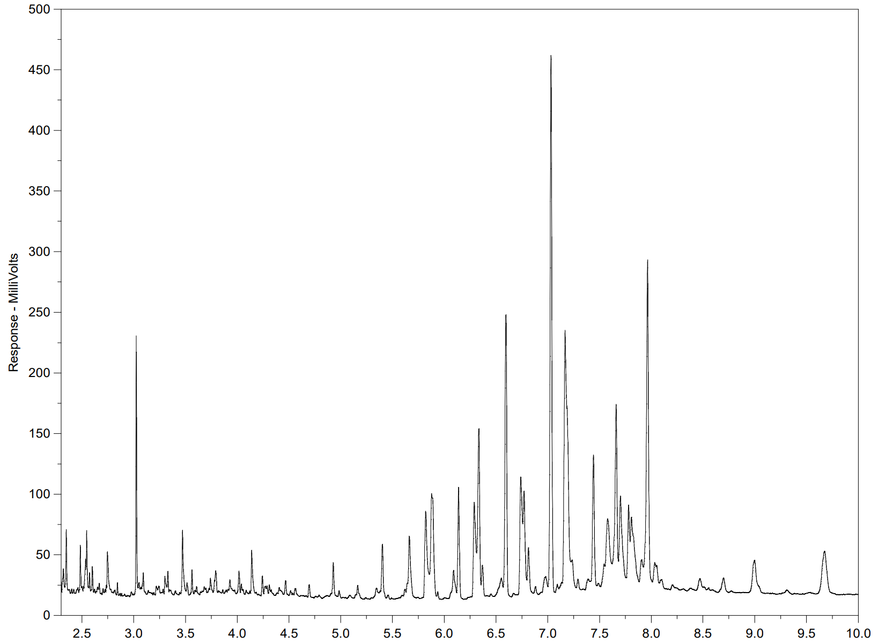
Biogenic Example: Muskeg

Slide 25
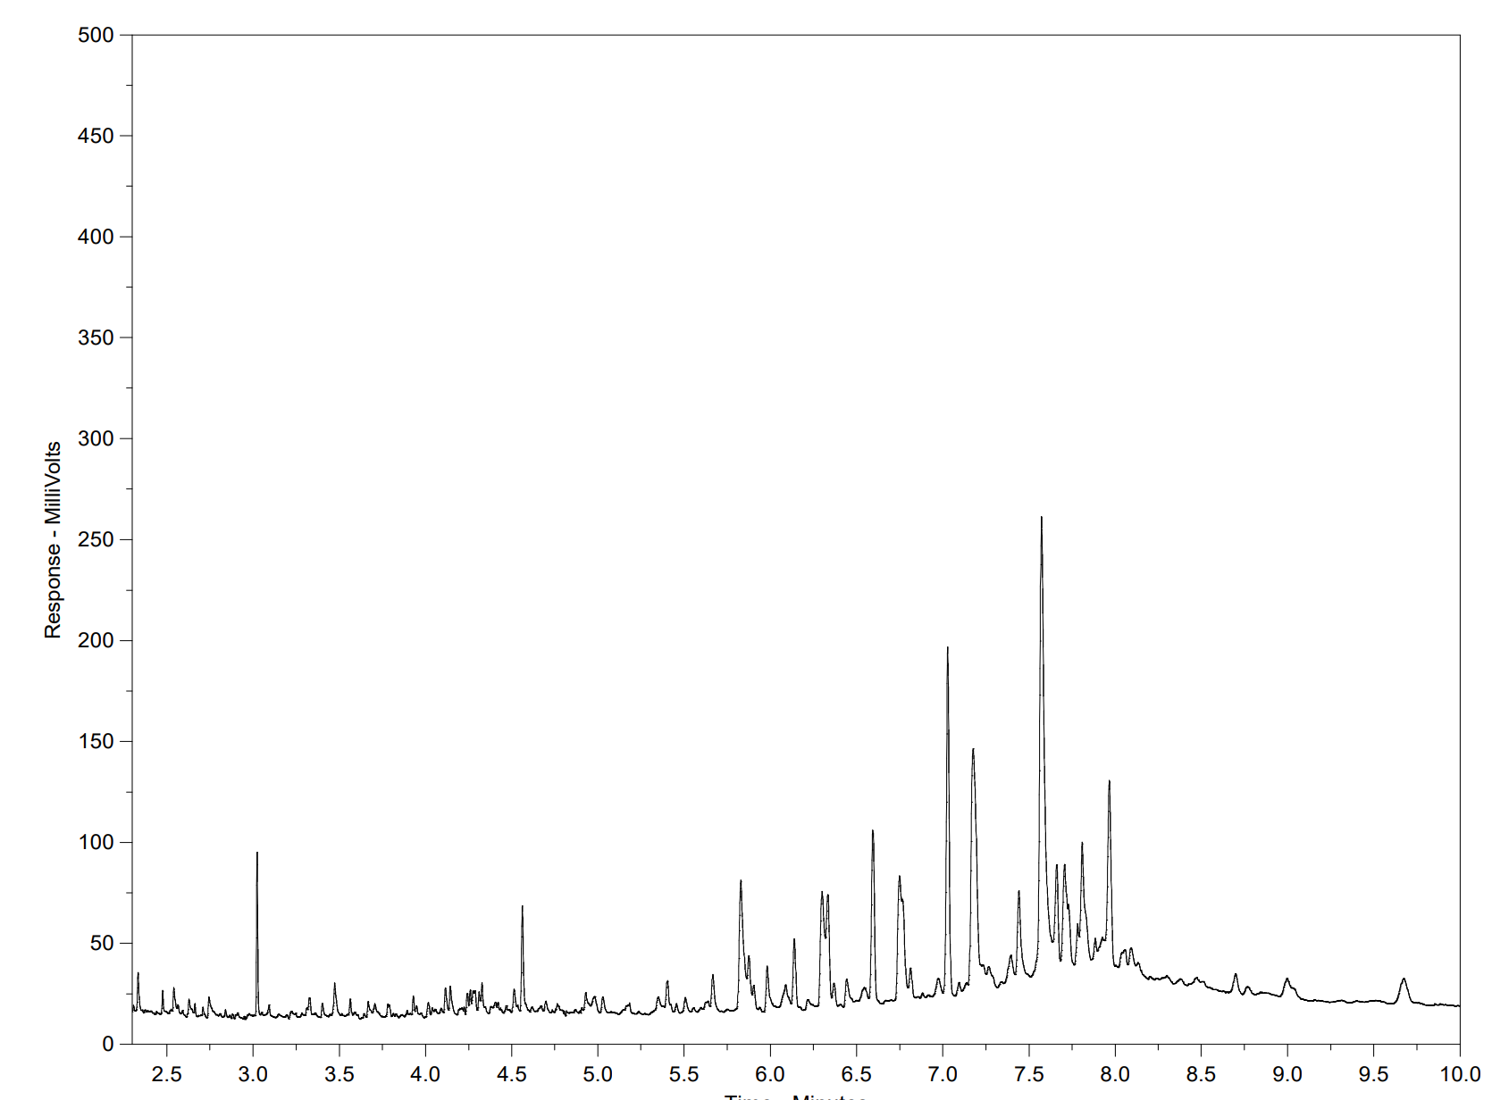
Biogenic Example: Muskeg (Silica Gel Clean-Up)

Slide 26
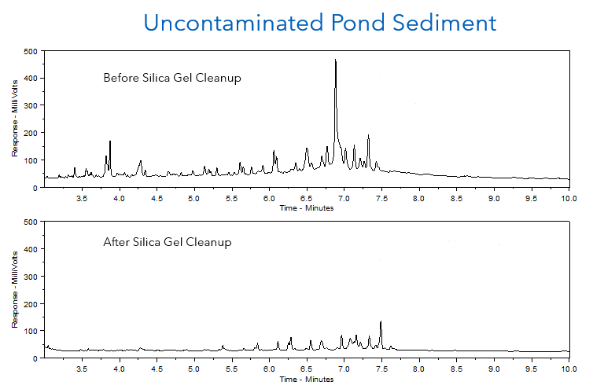

Slide 27
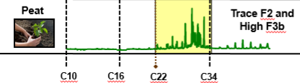

Biogenic Interference Calculation (BIC)
Accepted by Alberta AEPA. Can be used in other regions to support decision making.
Uses an F3 split (F3a C16-C23, F3b C23-C34) to evaluate potential biogenic interferences.
Certain criteria applies:
  PHC F2 concentrations are low (<30 mg/kg).
  Significant PHC F3 is present. F4 is present but not exceeding Tier 1 guidelines.
  The greater portion (>85%) of PHC F3 is in the F3b range.
If BIC values are <10%, this indicates potentially false exceedances for PHC F3.

Slide 28
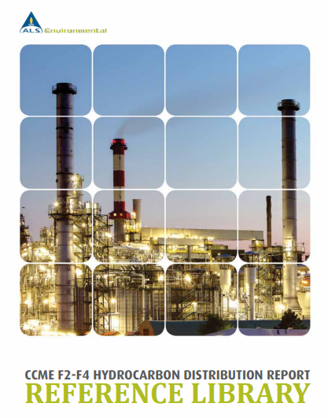
Summary
Hydrocarbon analyses are complex and non-selective.
Biogenic components are extracted with petrogenic sources.
Biogenic interferences can be (at least partially) removed using silica gel clean-up.
The use of comprehensive chromatographic review along with BIC evaluation can identify if biogenic interferences are present.

Slide 29
Thank you!
Questions?
Dwayne Bennett, P.Chem.
National Technical Specialist, Canada
2559 29 Street NE
Calgary, AB, Canada T1Y 7B5
dwayne.bennett@alsglobal.com
T: 1 403 407 1785

