Slide 1

When a Claim Comes: Strategies For Effective Outcomes

Slide 2
Overview of Presentation
Civil Claims Process in Saskatchewan
Limitation Periods
Litigation Risk Management
Strategies to Increase Successful Outcomes

Slide 3
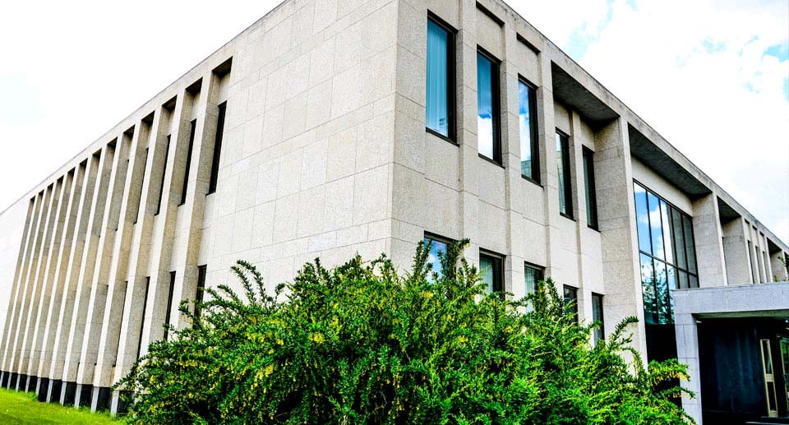
The Civil Courts in Saskatchewan
Small Claims Court
Court of King’s Bench
Court of Appeal

Slide 4
Mediation / Arbitration
Contractual Requirement
By Agreement: Parties may agree to mediation or arbitrate dispute

Slide 5
Steps in a Civil Claim
Procedures and practice governed by Rules of Court
Pleadings
Mediation
Document Disclosure
Questioning
Pre-Trial Conference
Trial

Slide 6
Pleadings
Statement of Claim
Statement of Defence
Third Party Claims
Client Role: Locate and provide information/documents to counsel to assist with preparation of pleadings

Slide 7

Mediation
Mandatory step after pleadings are completed
Attempt to resolve claim, or reduce scope of dispute
Client Role: Prepare with counsel and attend mediation

Slide 8
Document Production
All documents “relevant to a matter in issue”
Obligation to preserve documents
Client Role:
Search for and provide documents (including electronic files) to counsel
Take steps to preserve records
Swear Affidavit of Documents

Slide 9
Questioning
Obligation to answer relevant questions
Under oath
Potential for Undertakings
Client Role:
Obligation to inform yourself of material facts
Review of documents
Attend questioning
Seek out information to answer Undertakings

Slide 10
Summary Judgment
Can be used when facts are not in dispute
Not well suited in complex, multi-party actions or where there are conflicting expert opinions
Client Role:
Assist with preparation and provide affidavit evidence
Attend to be cross-examined upon affidavit evidence

Slide 11
Pre-Trial Conference
Mediation with a Judge acting as mediator
Most claims settle at this stage
If claim does not settle, matter is set down for trial
Client Role:
Participate in settlement strategy with counsel
Attend Pre-Trial Conference with counsel

Slide 12
Trial
Rare in civil claims
May not occur until years after Statement of Claim has been issued
Client Role
Potential for attendance as witness at Trial

Slide 13
What is a limitation period?
The time within which a civil action must be commenced
Statute based
The Limitations Act, S.S. 2004, c. L-16.1

Slide 14
Basic Limitation Period
No action shall be commenced with respect to a claim after two years from the date upon which a claim is discovered.

Slide 15
Why do we need a limitation period?
Encourages timely resolution of disputes
Reduces risk and uncertainty associated with potential claims
Prevents indefinite preservation of documents

Slide 16
Reasons to Avoid Litigation
A lawsuit requires significant time and resource demands
A lawsuit is distracting and stressful
Lawsuits (usually) do not conclude quickly
Outcome is (almost) always unpredictable

Slide 17
Typical Causes of Action
Breach of Contract: Breach of the contract with the opposing party
Negligence: Fail to live up to the standard of care of a reasonable, prudent and competent professional, in the circumstances

Slide 18
Strategies to Improve Chances of Successful Outcome:
Documentation
Importance of Documentation
  Confirmation of events, communications
  Direct evidence
  Aid to memory
Caution in use of language (expect that what you write will have to be produced)

Slide 19
From: George
Sent: Wednesday, August 13, 2014 3:29 PM
To: Judy
CC: Brandon; Lindsay
Subject: Re: XXX Condo
I really don’t care what he wants. There must be a village somewhere missing its idiot. Tell them he’s sitting in his trailer eating donuts and drinking coffee and they should really come get him.
Remind me again why we took this on? Let’s find a way to charge them double for all the time I am wasting answering his stupid questions.
From: Judy
Sent: Wednesday, August 13, 2014 1:14 PM
To: George
CC: Brandon; Lindsay
Subject: XXX Condo
Colin phoned again. He wants to talk about changing the location for the underground elevator access. And he wants to know when you will answer his question from yesterday.

Slide 20

Strategies to Improve Chances Of Successful Outcome: Document Retention
Develop document retention policy
Must include electronic records (emails, etc.)

Slide 21
Strategies to Improve Chances of Successful Outcome:
Best Practices
Recognize and report potential errors and risks
  Insurer can assist with potential claims
  Counsel can be appointed early
  Experts can be retained

Slide 22
Strategies to Improve Chances of Successful Outcome:
Contractual Protections
Contracts and Contract Terms
Delineation of Scope of work and definition of roles (design professionals, contractor(s), owner, etc.)
Limits on responsibility for actions of others
Limits on liability or recovery
Contract entirety

Slide 23
Take Away Messages
Claims are a risk to anyone in any profession
Be proactive in taking steps to position yourself and your firm to successfully defend if it does happen

Slide 24
Questions
McDougall Gauley LLP
Eric Mager and Sarah Wingerak
500 - 616 Main Street Saskatoon, SK S7H 0J6
T: 306.665.5442
E: emager@mcdougallgauley.com and
swingerak@mcdougallgauley.com

