Slide 1
Advanced AI and ML Strategies for Cost-Effective Environmental Liability Reduction in Resource Sectors
Brandon M. Smith (he/him)
President | Principal Risk Assessor
bsmith@clearsitesolutions.ca
Amy Gainer (she/her)
Senior Risk Assessor, Toxicologist
amy@clearsitesolutions.ca
1.855.53.CLEAR (532-5327) www.ClearSiteSolutions.ca
Notes:
Good afternoon. My name is Brandon Smith and I’m the co-founder of Quibbit Inc. and we’re here to make vehicle servicing simple.

Slide 2
Intro| What is AI/ML? | What can AI do | How AI “Learns” | Types | Prompting | Examples |
What is AI and ML?
What can AI do for us?
How AI “Learns”
Types of AI
Prompting
Examples

Slide 3
Intro| What is AI/ML? | What can AI do | How AI “Learns” | Types | Prompting | Examples |
AI is not taking your job
AI makes you better at your job
EFFICIENT
FASTER
SMARTER
Notes:
Mention here that AI is a major shift in technology moment in history. Similar to when everyone had to transition from fax to email. NOTE that this is a AI generated image of a fax machine…. And comment thawht every image in this presentation is AI generated….which means that there is no imagery copyright requirement and it certainly makes things simpler.

Slide 4
Intro| What is AI/ML? | What can AI do | How AI “Learns” | Types | Prompting | Examples |
Artificial Intelligence (AI) refers to the simulation of human intelligence in machines.
Machine Learning (ML) is a subset of AI that provides systems the ability to automatically learn and improve from experience without being explicitly programmed. ML focuses on the development of computer programs that can access data and use it to learn for themselves.

Slide 5
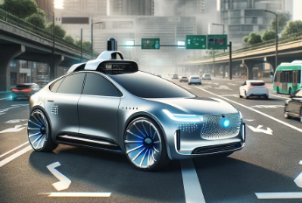
Intro| What is AI/ML? | What can AI do | How AI “Learns” | Types | Prompting | Examples |
Analytical laboratories
Voice Activated – Siri / Alexa
Recommended friends on Facebook
Self-driving cars
Online customer service “chatbots”

Slide 6
Intro| What is AI/ML? | What can AI do | How AI “Learns” | Types | Prompting | Examples |
Summarize
Convey information from a large report into a smaller report
i.e., Executive Summary, conclusions
Analyze
Assess information based on certain criteria
Extract
Obtain specific information from a document or database
i.e., answering questions, providing excel formulas

Slide 7
Intro| What is AI/ML? | What can AI do | How AI “Learns” | Types | Prompting | Examples |
Supervised Learning
Repeatedly training AI that this is a cat and this is a dog
Simple; possible in many free AI programs
Unsupervised Learning
Show AI a ton of data and let it look for patterns and connections without any human input
Complex
Reinforcement Learning
Combination of supervised and unsupervised
More complex
Occurs in ChatGPT when it asks “is the output for the second prompt better than the first”

Slide 8
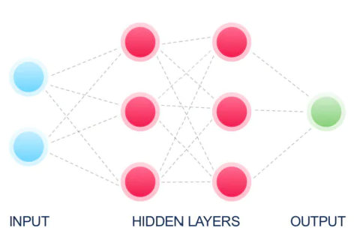
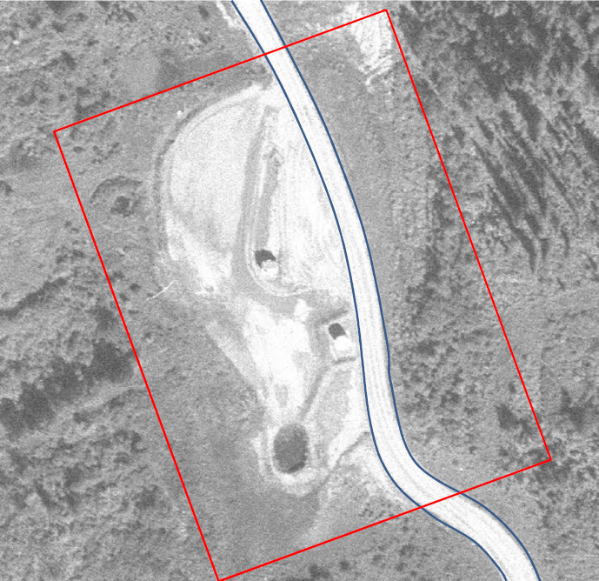
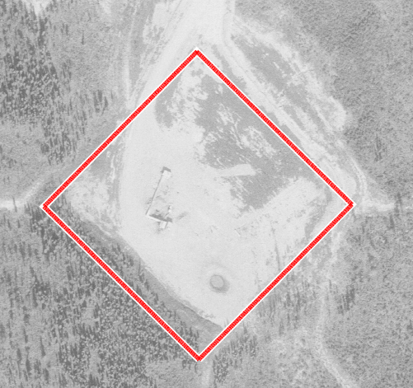
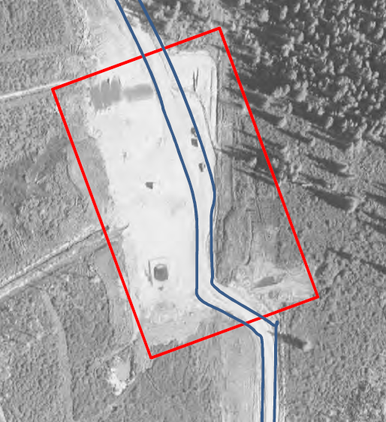
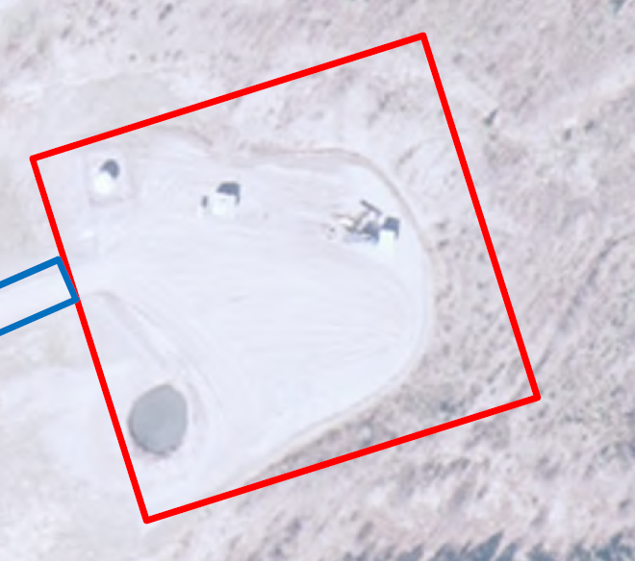
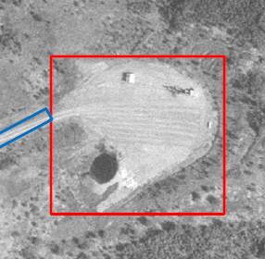
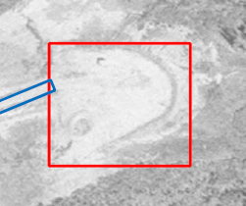
Intro| What is AI/ML? | What can AI do | How AI “Learns” | Types | Prompting | Examples |
Phase 1 ESA Aerial Photograph
Supervised and unsupervised learning
It’s a POND
It’s an AST

Slide 9
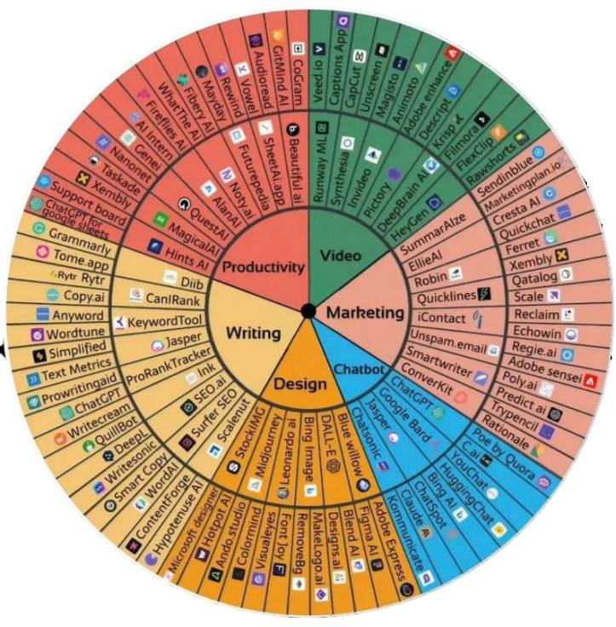
Intro| What is AI/ML? | What can AI do | How AI “Learns” | Types | Prompting | Examples |
Dash AI (automate writing)
ETL (extract | transform | load)
DataBricks (deployment)
Scikit (prediction modeling)
Notes:
Torch, Tenserflow others.

Slide 10
Intro| What is AI/ML? | What can AI do | How AI “Learns” | Types | Prompting | Examples |
Chatbots
Chat GPT - most common right now because free, comprehensive and accessible – 3.5 is free version;
4.0 is paid
Grok – X (Twitter)
Bard – Google
Copilot – Microsoft
Notes:
Asterisks are free ones

Slide 11
Intro| What is AI/ML? | What can AI do | How AI “Learns” | Types | Prompting | Examples |
Image Generating
Firefly - Adobe
Dall E – OpenAI
Krea – Creates images from field sketches
Notes:
The image was generated using adobe firefly

Slide 12
Intro| What is AI/ML? | What can AI do | How AI “Learns” | Types | Prompting | Examples |
Prompting is key to Generative AI Tools (like ChatGPT)
Siri/Alexa – responds to voice prompting
ChatGPT - responds to text prompting
Avoid ambiguity or vague prompts
If you give ambiguous prompts, you will get ambiguous answers
Concise, clear, specific and provide context
Concise – don’t provide too much info
Specific – the more specific, the better the response
Context – helps with a good response
Shorter sentences over long ones
Notes:
The prompts shown go from ambiguous to non-ambiguous.

Slide 13
Intro| What is AI/ML? | What can AI do | How AI “Learns” | Types | Prompting | Examples |
If you give ambiguous prompts, you will get ambiguous answers
“What are the common plants species in Saskatchewan?”
“What are the common plant species in southern Saskatchewan?”
“What are the common plant species in the Mixed Grassland ecoregion of Saskatchewan? Use the Environment Canada Ecoregions document as a primary source.”
“You are an environmental scientist. What are the common plant species in the Mixed Grassland ecoregion of Saskatchewan? Use the Environment Canada Ecoregion document as a primary source. Maximum 500 words”
Notes:
The prompts shown go from ambiguous to non-ambiguous.

Slide 14
Intro| What is AI/ML? | What can AI do | How AI “Learns” | Types | Prompting | Examples |
Defining Chemical Toxicity
“You are an environmental practitioner completing a contaminated site assessment. Generate a toxicity profile focusing on human health toxicity for toluene using health Canada or USEPA IRIS sources only. Maximum 500 words”

Slide 15
Intro| What is AI/ML? | What can AI do | How AI “Learns” | Types | Prompting | Examples |
Liability Analysis
Started with 2,362 Phase 1 ESAs, 397 Phase 2 ESA and 156 Remediation Projects
Evaluated Predictor variables (Pass vs. Fail)
Created a mathematical relationship for prediction of Pass vs. Fail ratios and decision tree statistical learning model from 24 predictor variables (spud date, production volume etc.)
Using a multi-linear regression model generated a prediction forecast for FAIL Rem Vol.
Notes:
Stage 1 – set the foundation for addressing site issues with appropriate APEC and COPC analysis. Automation of this process with

Slide 16
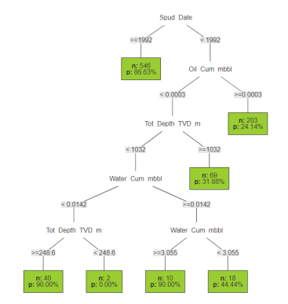
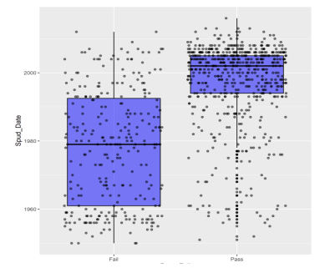
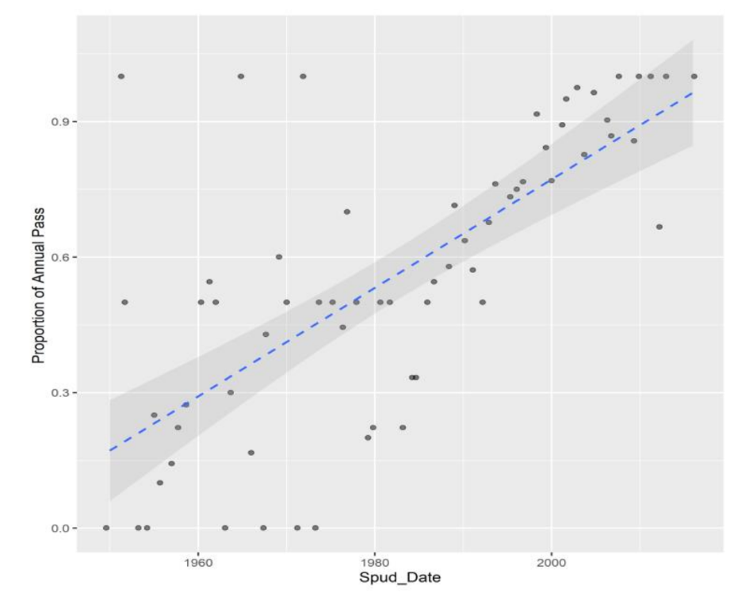
Intro| What is AI/ML? | What can AI do | How AI “Learns” | Types | Prompting | Examples |
Notes:
Stage 1 – set the foundation for addressing site issues with appropriate APEC and COPC analysis. Automation of this process with

Slide 17
Intro| What is AI/ML? | What can AI do | How AI “Learns” | Types | Prompting | Examples |
Imagery for Conceptual Site Model Derivation
Convey a message clearly to general audience
Avoids copyright issues
Cost Conscious (as compared to Adobe Stock)
Notes:
Example of a basic prompt to make a cross section. The prompt can be revised for more details. Just showing the capabilities and potential with using AI

Slide 18
CONTACT INFO
Brandon Smith
M.Sc., P.Biol, RP.Bio, EP, QP
Amy Gainer
Ph.D., P.Ag.
President
Senior Risk Assessor
Brandon@clearsitesolutions.ca
Amy@clearsitesolutions.ca
Notes:
Stage 1 – set the foundation for addressing site issues with appropriate APEC and COPC analysis. Automation of this process with

Slide 19
Intro| What is AI/ML? | What can AI do | How AI “Learns” | Types | Prompting | Examples |
Generate Property liability based on fundamental risk principals that are derived by customized data models and functions
Calculate the fair-value market liability for Tier 1 (Generic) site remediation. When combined with the property value and ARO commitment we create the generalized Asset Liability Ratio (ALR). This ratio provides clients with a quick method for risk-ranking site and expenditure activity
Combining our AI, ML and Remedial Options process we generate a streamlined path to Tier 2 (Site-Specific Risk Assessment) liability analysis in less time and at less cost. Together with the ALR we can provide index costs to management to evaluate spend/success ratio on liability closure options and site selection
We then inform our model with past client projects on scope/cost/success and refine our current program designs to create a detailed risk-forecast on spend value. Qualifiers such as ease of access, landowner constraints and time-concerns (off-site permitting) can be included as risk-modifiers
Notes:
Stage 1 – set the foundation for addressing site issues with appropriate APEC and COPC analysis. Automation of this process with

