Slide 1
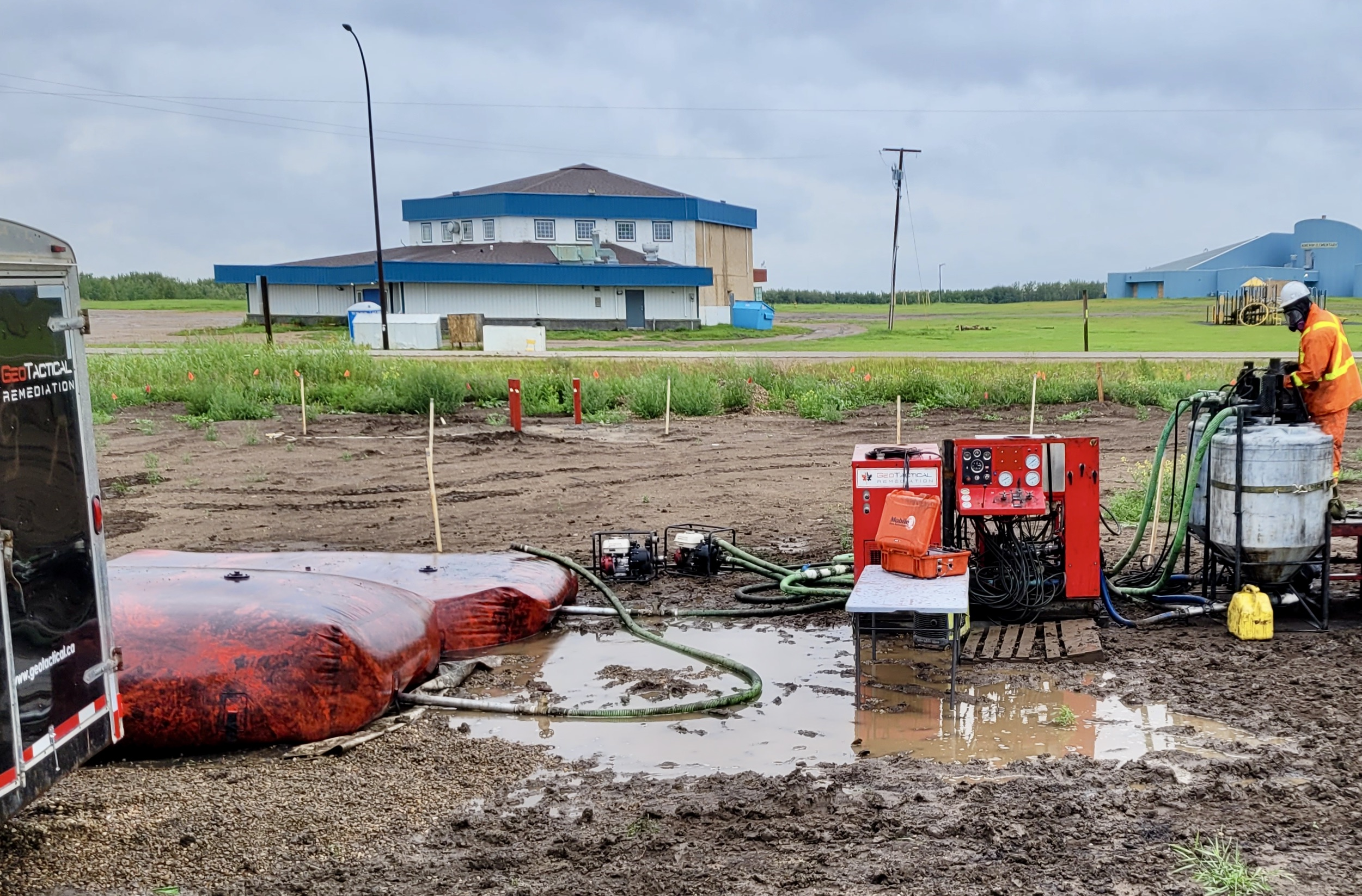

Achieving Site-Specific Remedial Goals for PHCs, PAHs, and VOCs through a Collaborative Multidisciplinary Approach
SustainTech 2024
Gord Guest - Geo Tactical Remediation Ltd.

Slide 2
General Site Description
Site is located on Kehewin Cree Nation No. 123
  Former gas station, currently inactive and unoccupied
  Site contaminated due to UST’s requiring removal
  Centrally located with several administrative facilities and schools located nearby.

Slide 3
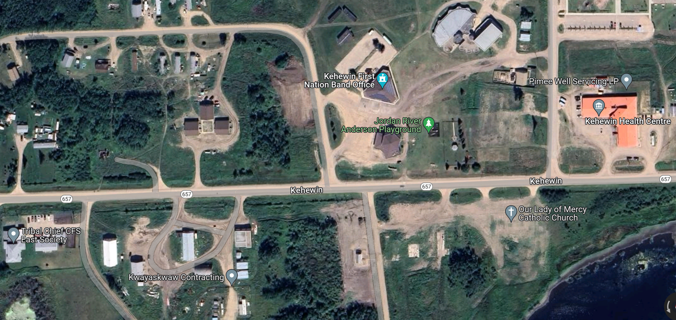
Image of Area

Slide 4
Environmental Work
UST’s had been installed in early 1990s
Phase II ESA conducted after tank removal.
  Tanks were pulled and 2 monitoring wells were installed in 2017
  Detailed Phase II performed in 2020 and elevated LNAPL free phase found elevating site priority under FCSAP
Hydrocarbon impacts were found in the soil and weathered bedrock:
  BTEX’s, PHC’s and naphthalene were detected at concentrations above reference guidelines.
Notes:
Detailed Phase II in 2020 found free phase LNAPL elevating the site priority
PHC concentrations above guidelines

Slide 5
Project Objective
Main site objective for project was to advance the site in the Federal Contaminated Sites Action Plan:
  Remediation of site to functional land use
  Source removal and subsequent risk management
Notes:
Objectives:
Return site to functional land use
Source removal and overall contaminant reduction then a risk management plan

Slide 6


Geo Tactical Remediation Ltd.
Who we are
What we do
Environmental service company
  Speciality: In-situ injection remediation
Based in Calgary, AB
Service backed by science
In Situ Injection Services
  Permeation (Matrix) Injection
  Fracture Injection
3D Tiltmeter Mapping
Assist with developing in-situ remediation programs
Notes:
Geo Tactical brought in brought into project for injection component, Injection specialist, both permeation and fracture injection

Slide 7
Stakeholders
Client and Project Oversight – Kehewin Cree Nation No. 123
Funding – Indigenous Services Canada
Overall Project Management – Bosgoed Project Consultants
Technical Project Management – Associated Environmental Consultants
Injection Services – Geo Tactical Remediation Ltd.
Thermal Services - Nelson Environmental Remediation
Site goals
  CCME guidelines
  Community engagement

Slide 8
Community Business Engagement
Local contractors
  Personnel to assist with injection
  Snow clearing
  Fuel
  Site cleanup
  Security
  Aided in sourcing additional community-based services
Notes:
Contractor from the community provided a variety of services including assistance with injection operations.
Also connected us other local services, welder, electrician

Slide 9
Effective Collaboration
Flexibility in site schedule and plan adjustments due to unexpected site conditions
Close communication and transparency allowed for rapid site plan adjustments
  E.g., adjustment in sampling event time to allow for clearer picture of amendment effectiveness.
All stakeholders involved in significant site plan adjustments.
  Allowed rapid implementation and reduced delays
Notes:
Some changes in scheduling and the injection plan were required. It was easy get meetings with the stakeholders in a timely manner and decisions were made allowing work to continue without undue dely.

Slide 10
Technology Disciplines Applied
Onsite ex-situ thermal desorption by Nelson for areas with free phase and small volume near surface contamination.
In-situ bioremediation injections selected at depths greater than 2 metres (GTR) outside and under of free phase footprint.
Notes:
Nelson did thermal desorption to treat zone of high contamination and shallow area are where in-situ bio remediation would not have bee practical.
We did bioremediation injections below the high contamination zone and across other areas of the where the contamination was deeper than 2 m.

Slide 11
Why Bioremediation
Bioremediation approach chosen for:
  Contaminant type: BTEX, F1 and F2, naphthalene, MTBE…
  Hydrogen peroxide highly reactive and limited longevity- geology concerns with clays
  Alternate Oxidants: Residuals concern
Bioamendments are safer to handle and provides longevity.
  Safety aspect of site location and allowed for onsite local engagement (oxidant has significant training requirements)
Notes:
Hydrogen peroxide not suitable for the site due lower permeability soils, can get uncontrolled pneumatic fracturing and is short lived treatment
Bioremediation is suitable for the contaminants present on site and provides greater treatment longevity.
Bioremediation amendments are safer to handle than handle allowing us to involve personnel from the community in the injection operations

Slide 12

Amendments Injected
PTS – Biostimulation package (nutrients)
PTBac – Microbial bioaugmentation blend of aerobic and anaerobic microbes
iPAC – Activated Carbon
  Adsorption, enhanced biofilm production, increased residence time
Sand proppant – Provide permeable pathways for multiple injections without the need to re-mobilize drilling equipment.
supplied the Bioremediation Amendments
Notes:
We injected nutrients (PTS), aerobic and anaerobic microbes (PTBac) as well as powdered activated carbon (iPAC), all supplied by CERES
We also injected sand proppant in one area to be used for multiple injections without the need to remob a driller

Slide 13
Site Geology and Contaminants
Geology
  GW between 1.5-2m bgs
    No significan GW gradient
  Soils are primarily clay and silts with some layers of sand and gravel.
  Silty clay shale bedrock underlying contaminated site area
Contaminants
  GW- BTEX, PHC fractions F1 and F2, naphthalene
  MTBE
  Soil- BTEX, PHC fraction F1, and naphthalene
Notes:
GW shallow, primarily clay and silts but some sands and gravels.
BTEX, F1, F2, naphthalene and MTBE primary CoCs in GW
BTEX, F1 and naphthalene CoCs in soil

Slide 14
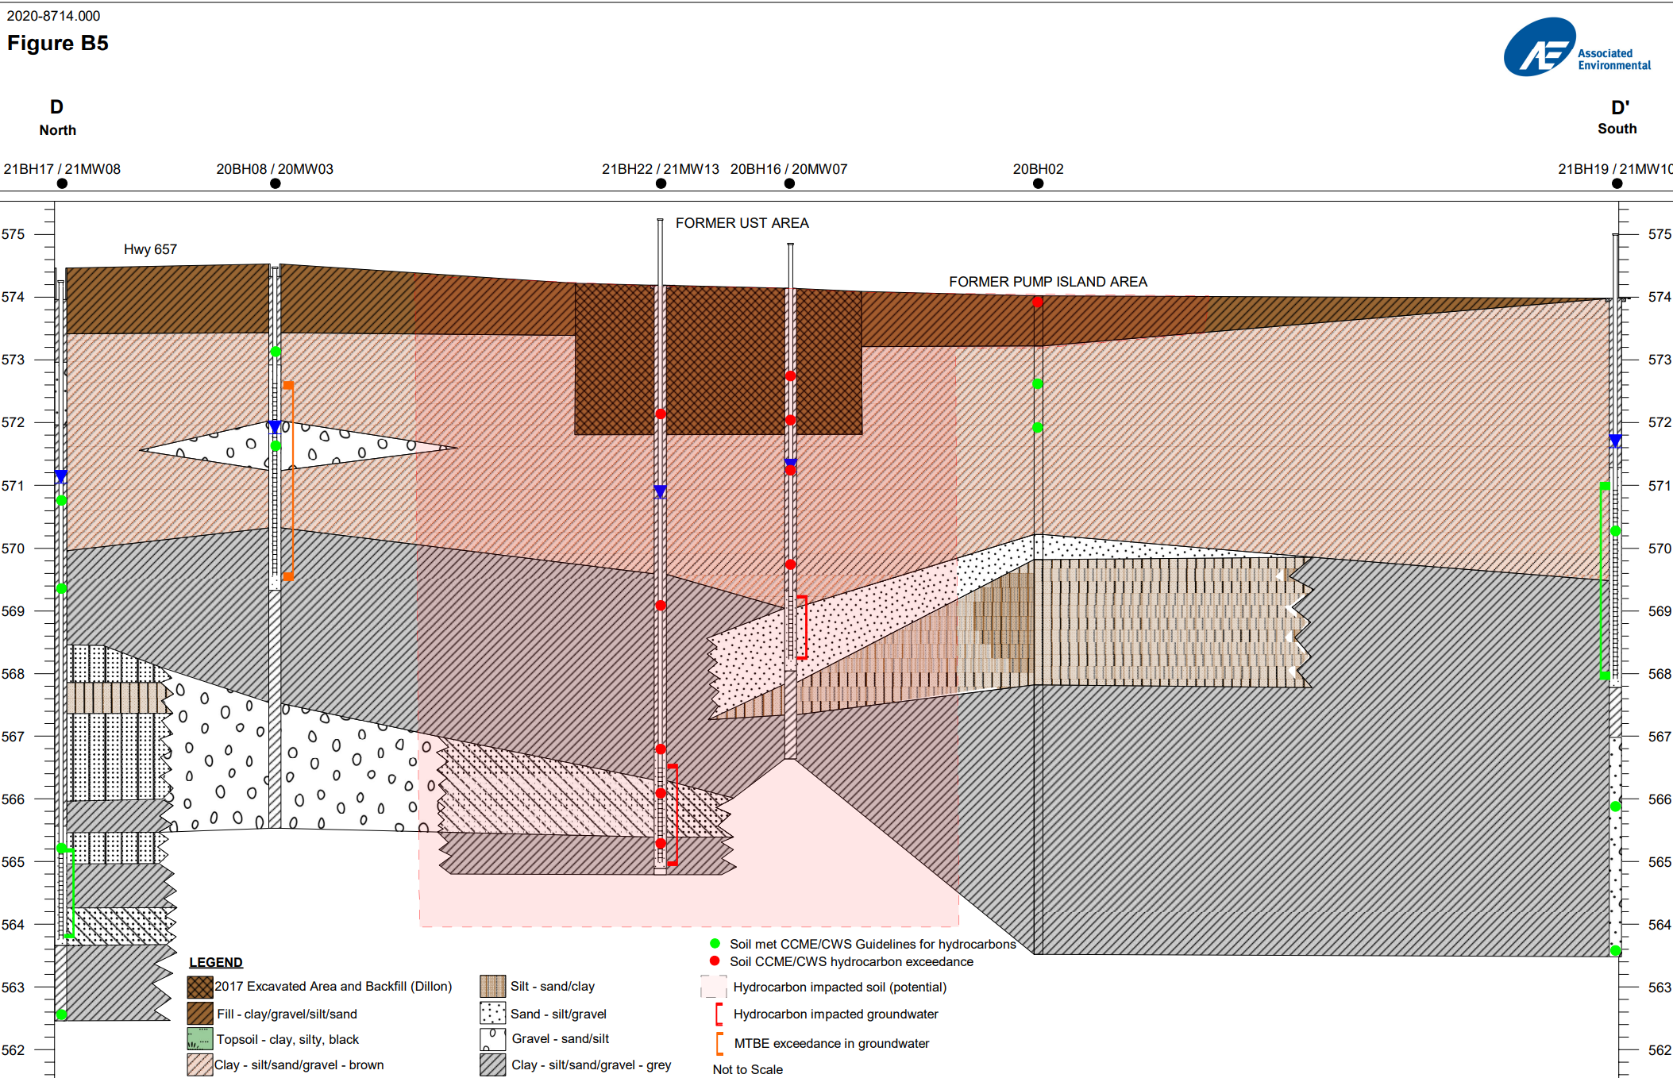
Notes:
Complex geology- multiple pathways for contamination to move both laterally and vertically - Geology described as crazy

Slide 15
Site Plan (2,070m²)
6000m³- 0-14m bgs
4500m³- 2-10mbgs
B
A
C
D
4000m³- 0-8m bgs
25m³- 0-1m bgs
E
225m³- 2.5-3.5m bgs
Notes:
Total area just over 2,000 m2, divided into 5 areas
Thermal treatment for soils excavated to 5 m in area B and for area D – small shallow zone
Contaminant depth ranges varied with deepest zone in B at 14 m
Building bottom right no longer

Slide 16
Injection: Modes of Emplacement
Fracture Injection
  Direct injection emplacement of remediation amendment
      PTS, PTBac and iPAC
  Sand propped fractures (Area B) – for multiple solution injections
      iPAC included
Permeation Injection
  Into sand propped fractures through installed injection wells (Area B)
      PTS and PTBac
Notes:
Drilling method does not determine mode of injection – mode is determined by flow rate relative to flow capacity of matrix being injected into
Direct Injection is a method of sealing hole to allow pressure in the injection zone

Slide 17
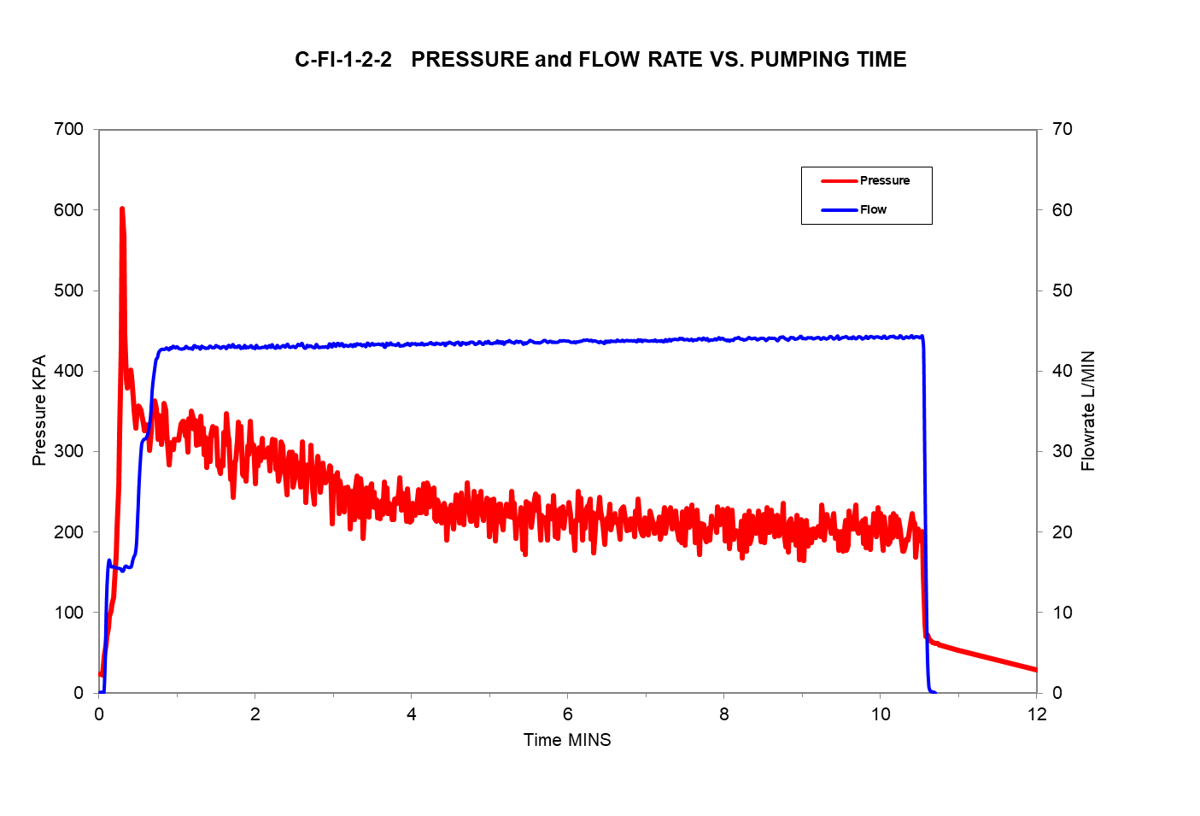
Pressure-Flow Rate – Time Plot of Fracture Injection

Slide 18
Injection Summary
Injection Event, Area, Completion Date | Number of Injection Locations | Number of Injection Intervals | Number of Wells Injected | Total Injection Volume (m³) | Total PTS Injected (kg) | Total PTBac Injected (kg) | Total iPAC Injected (kg) | Total Sand Injected (kg)
1 (All Areas), March 2022 | 72 | 352 | 20 | 229 | 11,170 | 128 | 10,995 | 59,575
2 (B &C) October 2022 | 22 | 111 | 2 | 51 | 5,125 | 27 | 1,020 | NA
3 (B&C) August 2023 | 43 | 264 | NA | 108 | 2,335 | 66 | 4,710 | NA
Total All Injections | 137 | 727 | 22 | 388 | 16,295 | 155 | 16,725 | 59,575
Notes:
Shallow and deep injection well at each of 10 locations where sand propped fracturing was done, injected all 20 wells first injection, and the deep and shallow at only one location the second injection.
Injections in areas B and C only for 2nd and 3rd injection

Slide 19
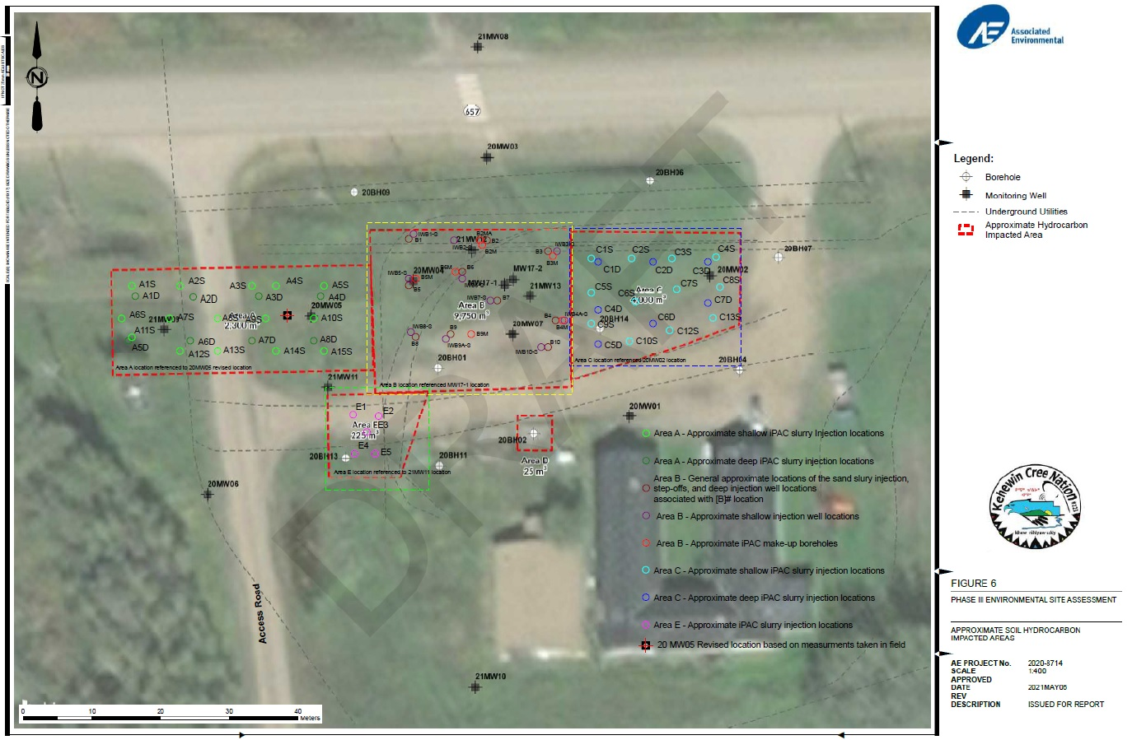
Notes:
Injection locations
Area A example Different volumes for shallower and deeper treatment, more volume for deeper and greater lateral spacing

Slide 20
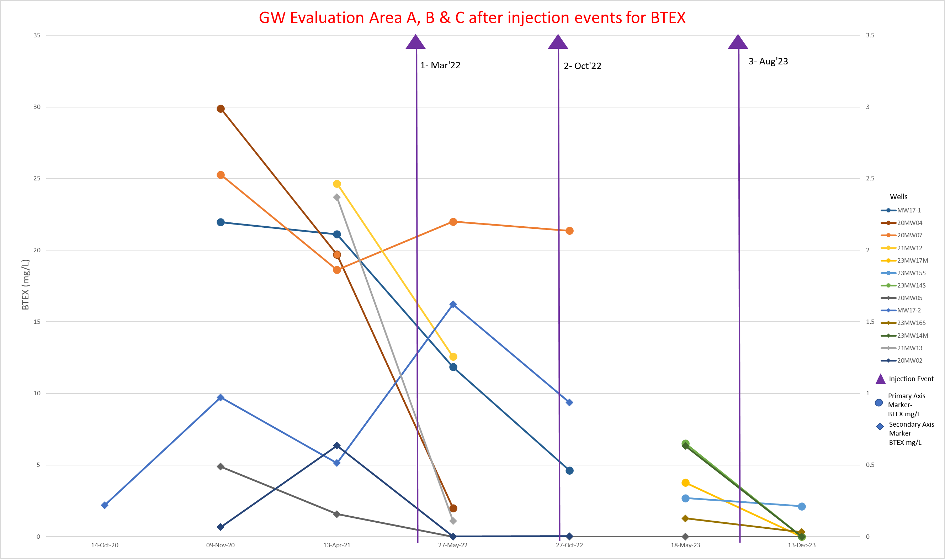
Notes:
Lines with diamond are for values on right axis
General downward trend, exception orange line is in area B in area where surfacing occured

Slide 21
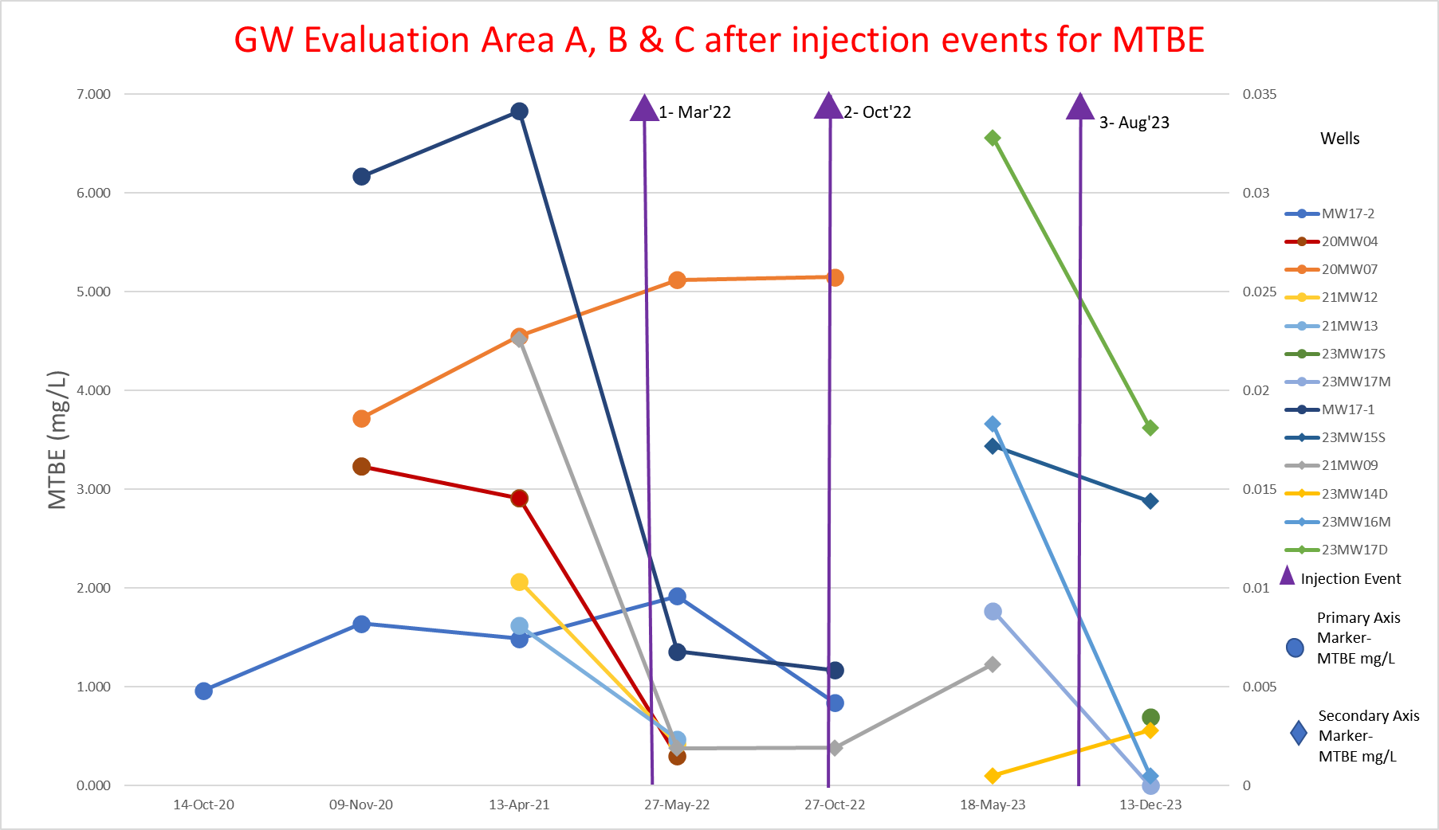
Notes:
Again general downward trend – orange line (20MW07) again exception

Slide 22
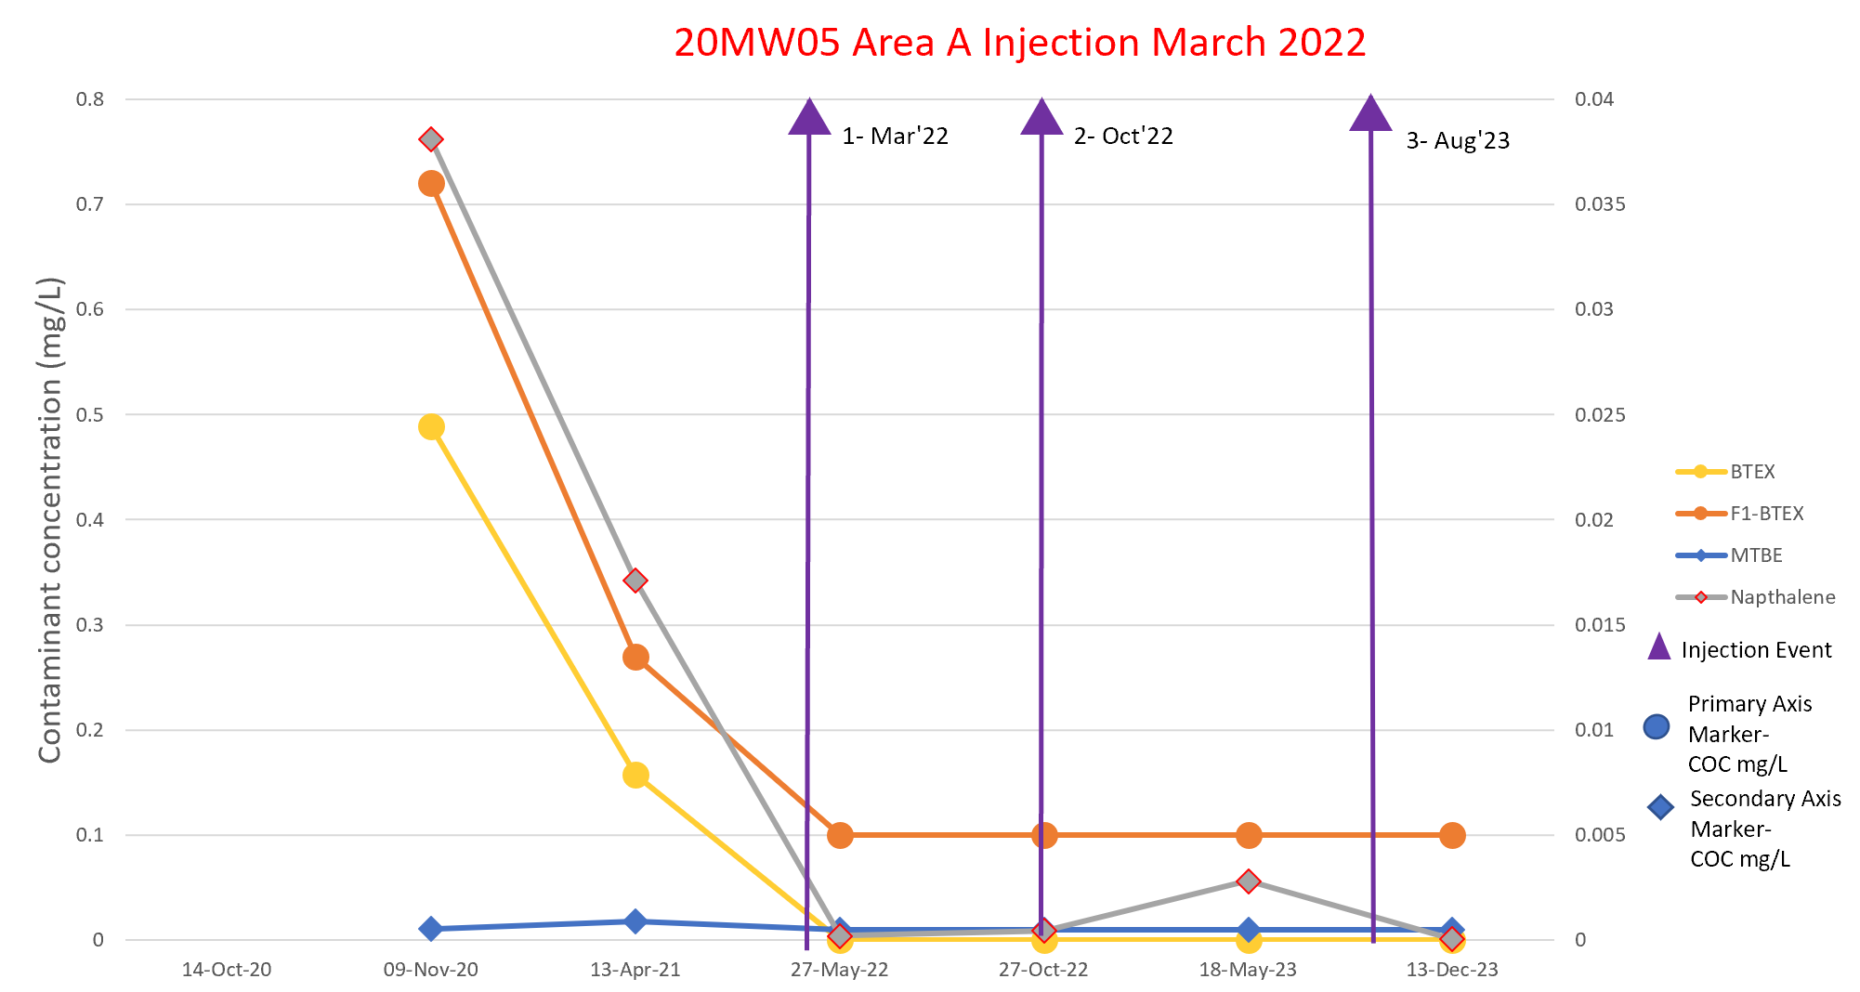
Contaminant of Concern

Slide 23
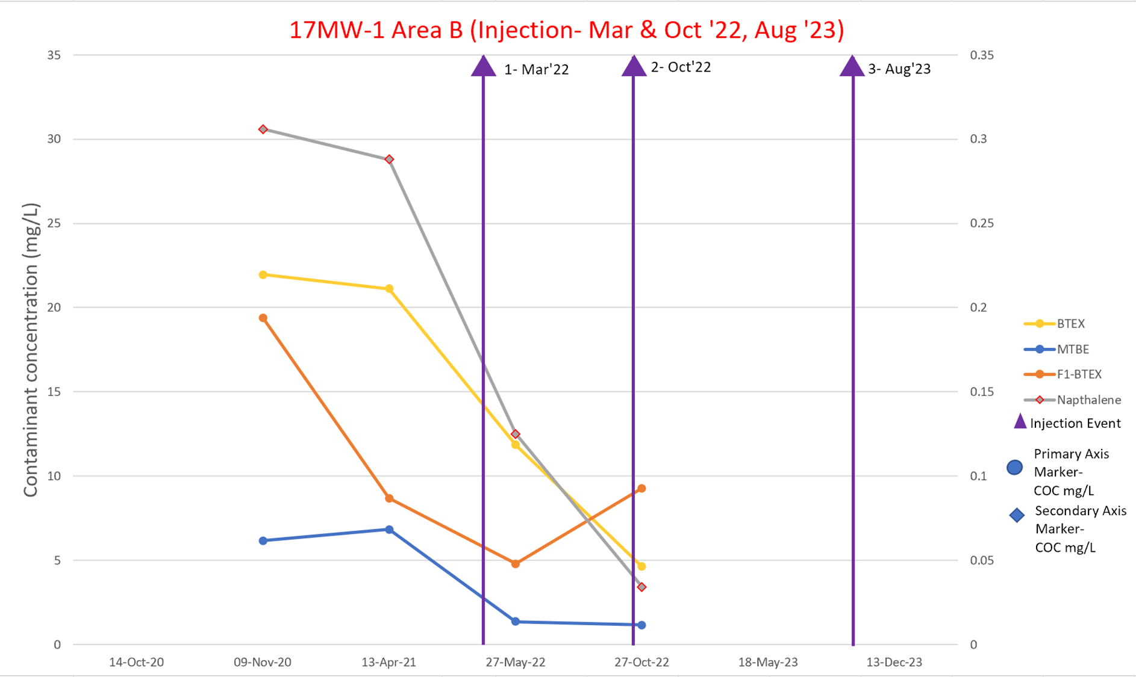
Contaminant of Concern
Notes:
Most CoC down.
Well removed during excavation

Slide 24
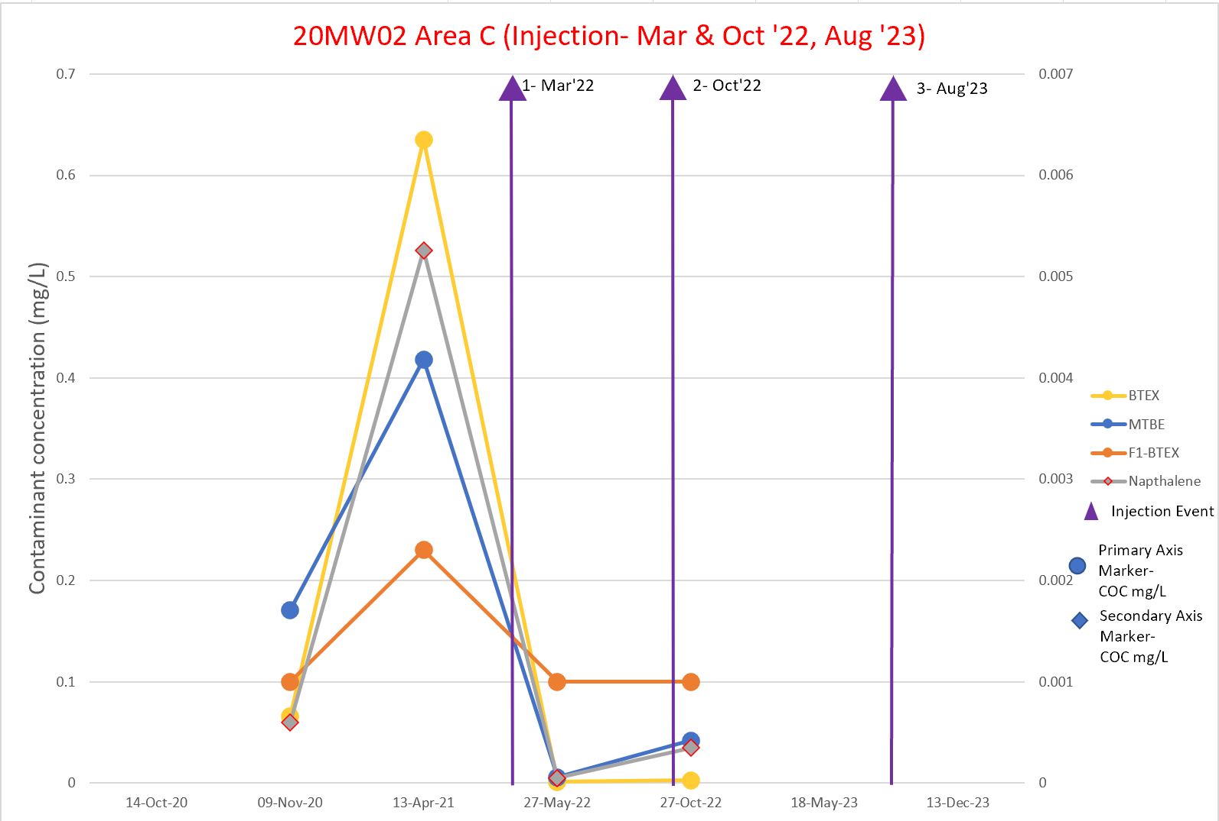
Contaminant of Concern
Notes:
General decrease, some rebound in Naphthalene and MTBE

Slide 25
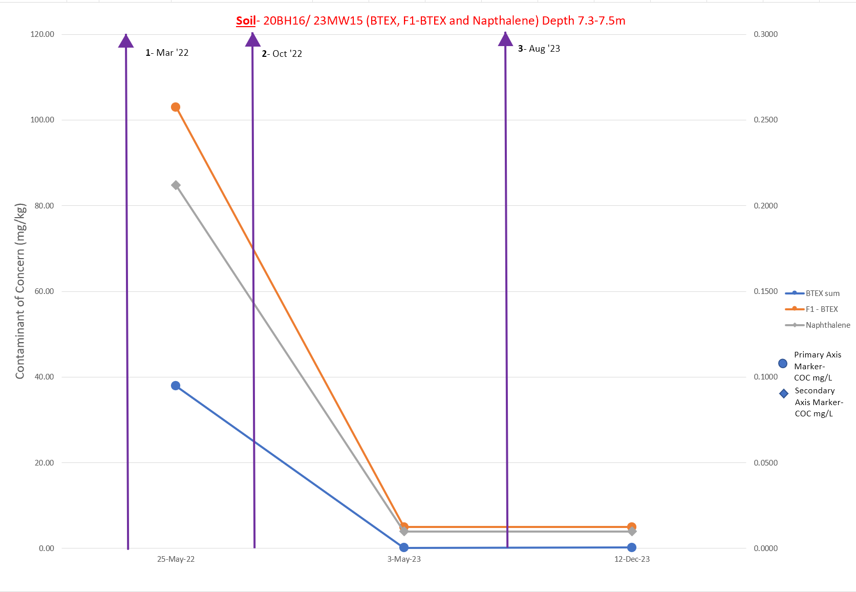
Contaminant of Concern
Notes:
Soil limited comparable information – decrease seen

Slide 26
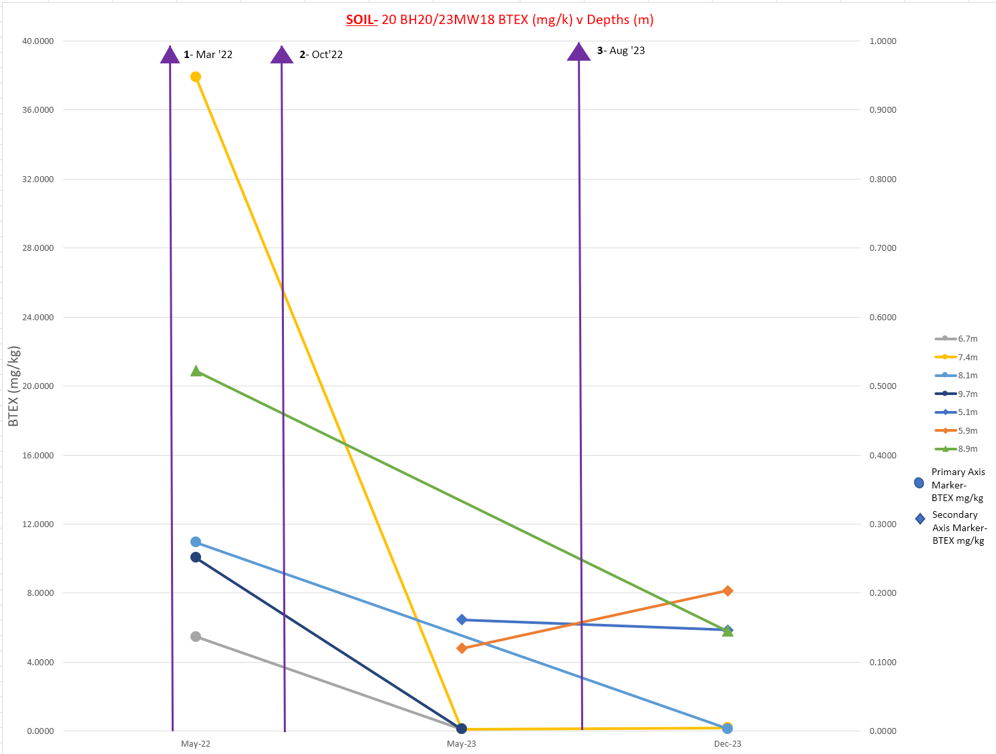
Depth (m)
Notes:
Decrease

Slide 27
Anaerobic Biodegradation Parameters
Notes:
Terminal electron acceptors present, low dissolved oxygen and ORP – conditions for anaerobic degradation

Slide 28
Challenges Encountered
Challenge | Action
Coinciding projects- Lift station build occurring at the same time | Clear communication between all contractors and stakeholders to move forward with minimal delays
Surfacing in some parts of Area B and C. | Additional injection locations were used.
Sand propped fracture network less effective for permeation injection than expected due some surfacing and a high degree of interconnection. | Amendment injected with fracture injection was increased, particularly for Injection 2.
Unmarked, difficult to locate, and conflicting As Builts resulted in encountering unexpected utilities. | Injection 3 adjusted to accommodate amendment mass not used in Injection 2 and remaining mass of PTS used to treat open excavation.
Notes:
Communication required to co-ordinate with other work on site
Added additional injection locations due to surfacing
Injection wells did not work as well as planned, adjustment made by switching to fracture injection to emplace amendments

Slide 29
Conclusion
Collaboration is ”KEY” for projects with multiple stakeholders
  Clear and consistent communication important when project adjustments need to be made
Injection services benefited from local engagement
Multi-discipline approach to reach remediation and risk management goals
Notes:
- Clear and consistent communication with all stakeholders important for efficient operation making adjustments to schedule and plan
- Injection project benefitted from using local contractors, great service – quick response
- Combination of in-situ and on-site ex-situ best approach to achieve goals

Slide 30



Thank you to all partners!!
Merissa Knapton
Brent Schmidt
Denise Hourd
Bosgoed Project Consultants
Gary Bosgoed
John Tucker

Slide 31
Questions??
Contact information:
Denise Hourd- Kehewin Cree Nation – denise@kehewin.ca
Gord Guest- Geo Tactical Remediation – gguest@geotactical.ca
Brent Schmidt- AE – schmidtb@ae.ca

